Slide 1
Training an Eye in the Sky
Image Detection with Machine Learning
4-22-2020
Nick Harbeck
XinyuYao

Slide 2
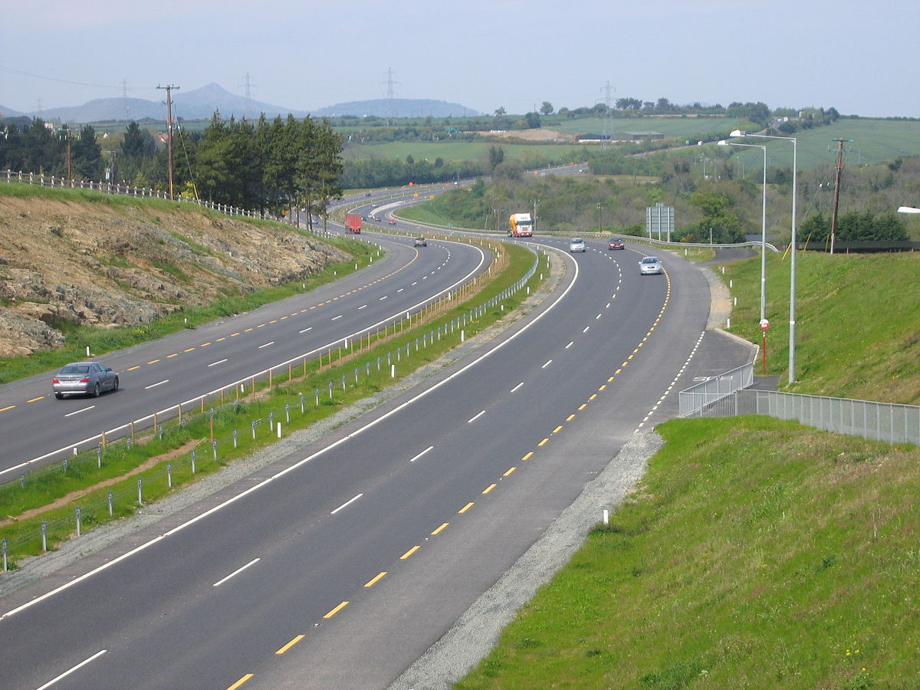
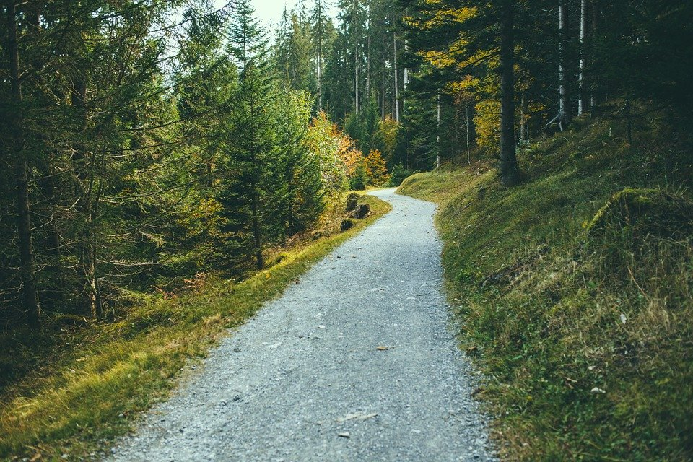
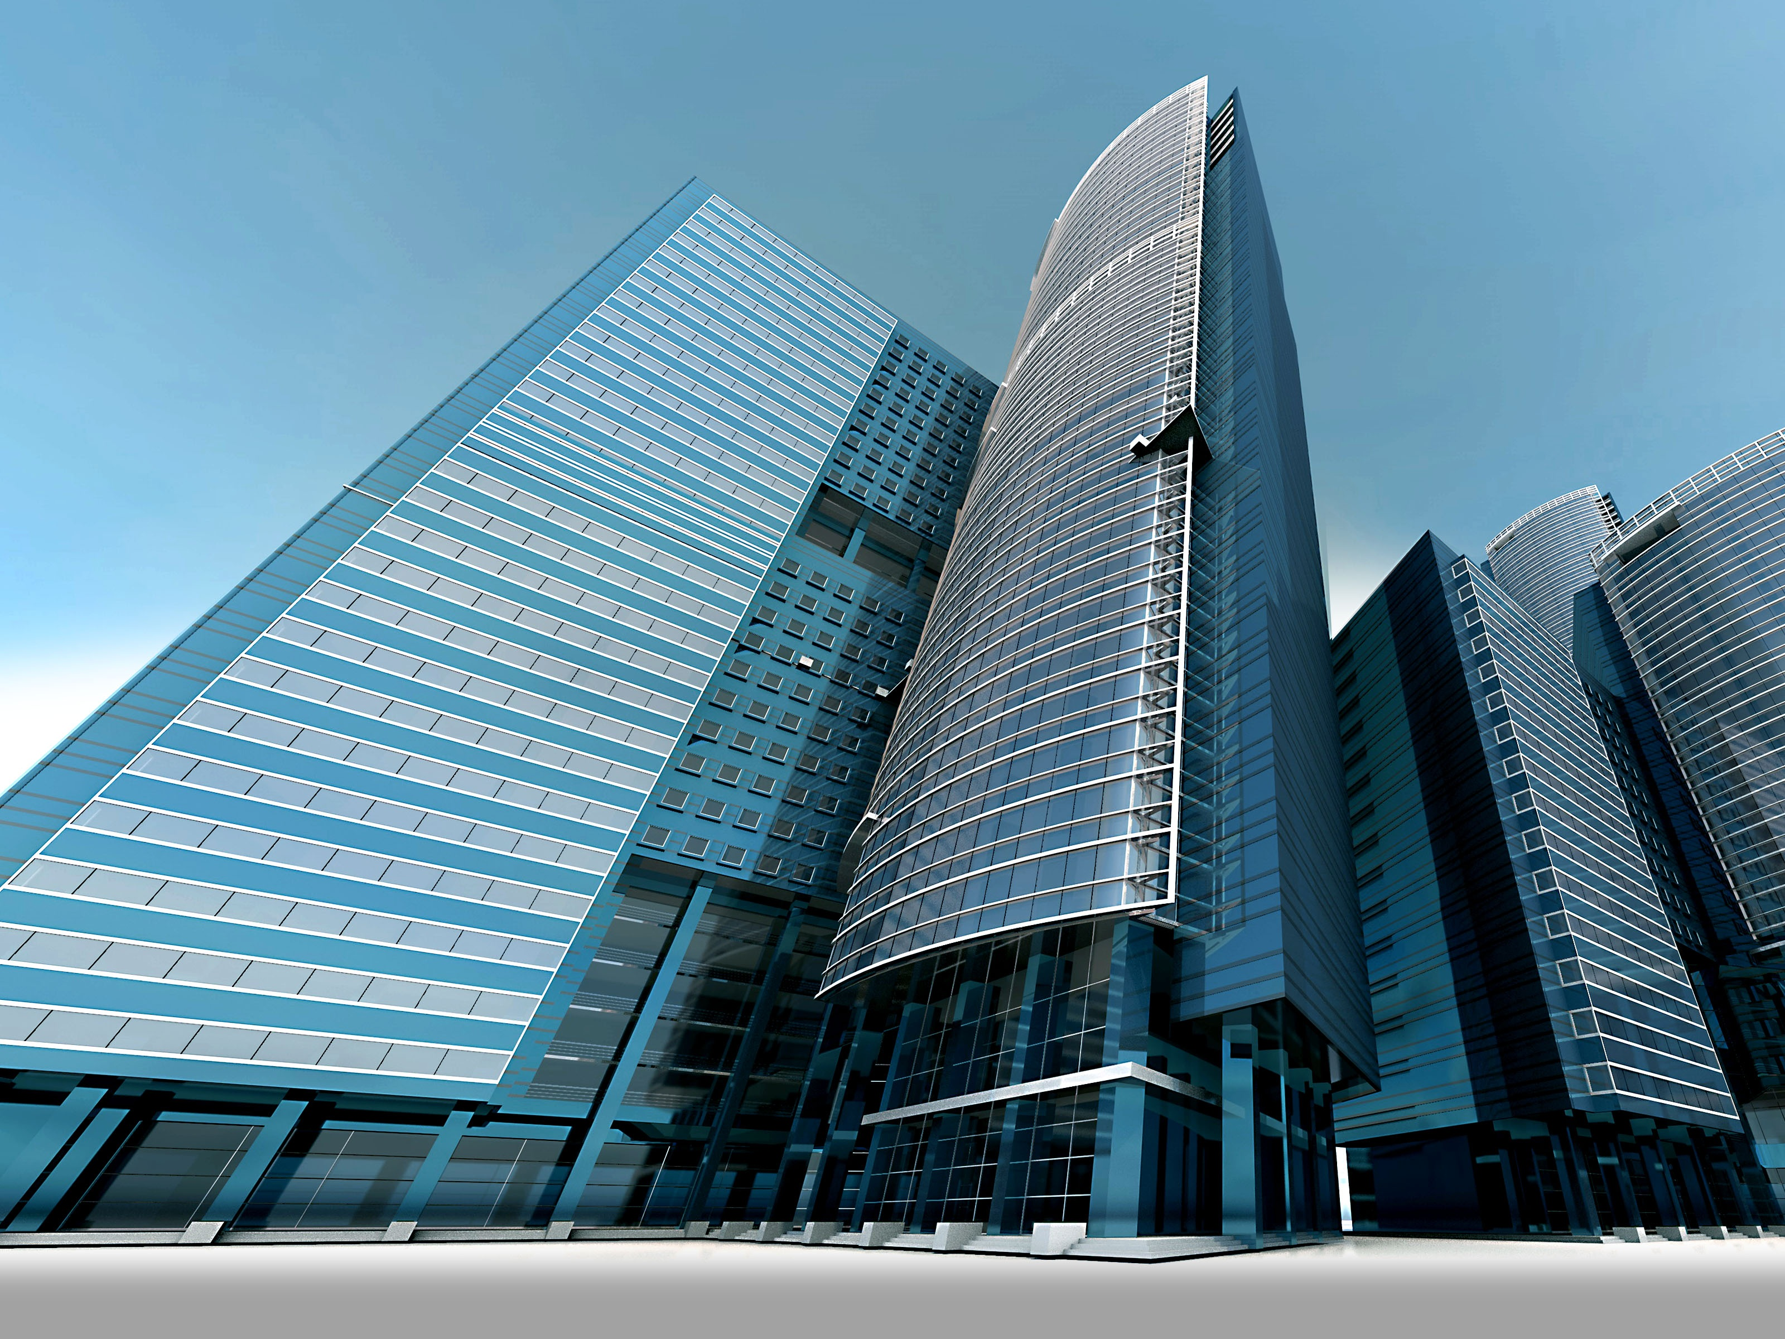
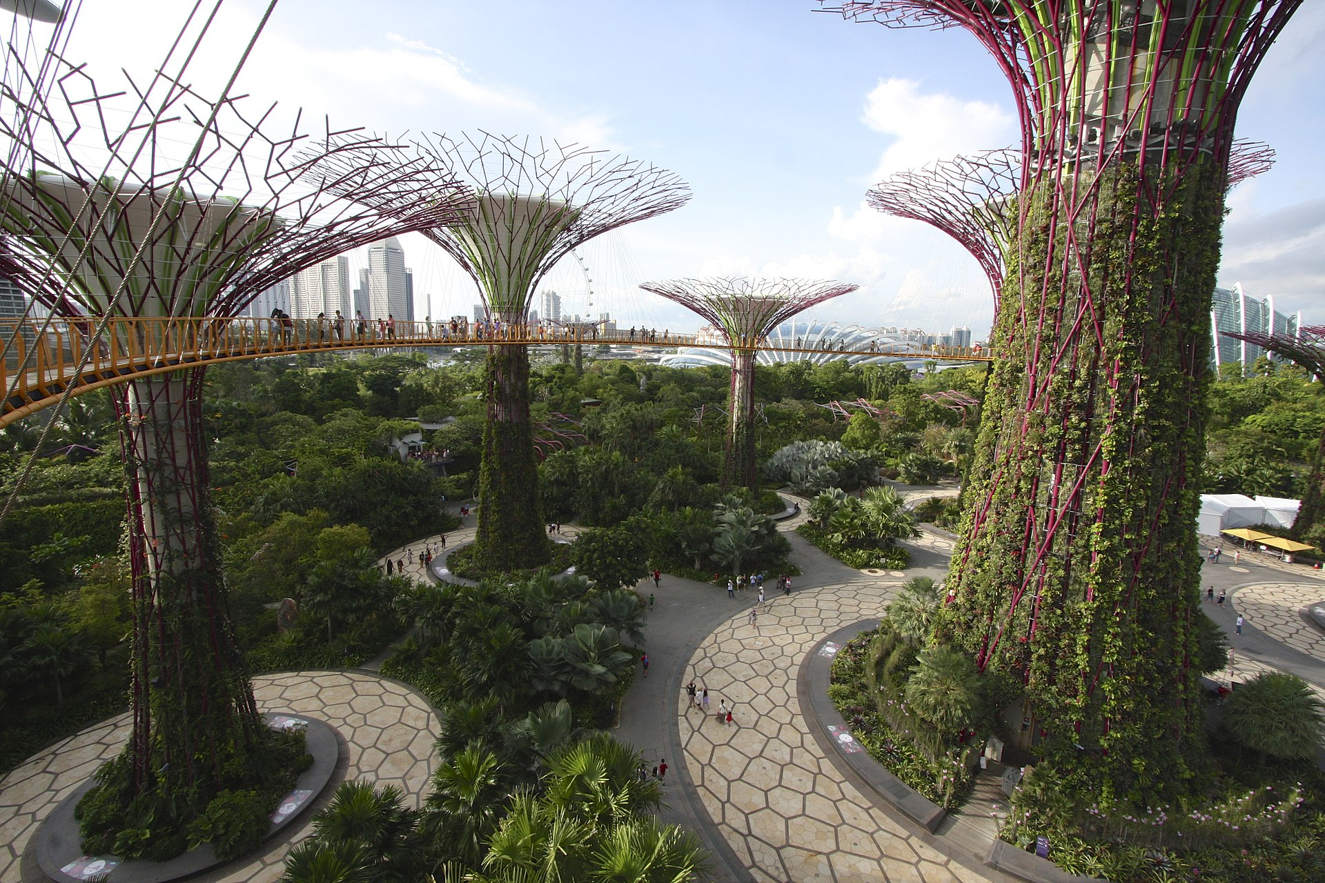
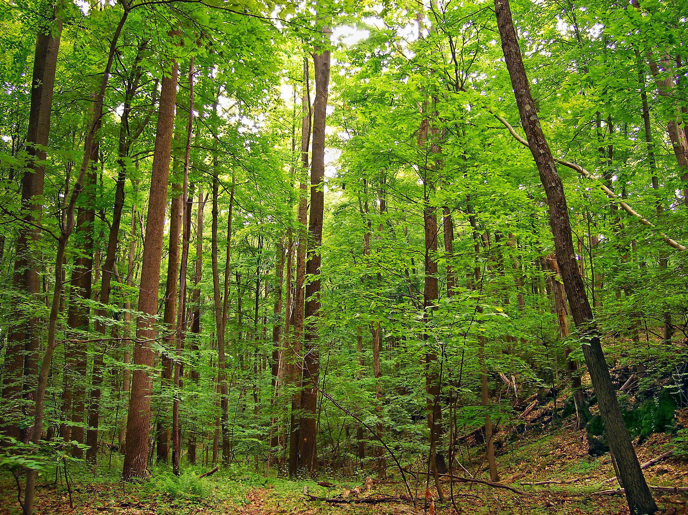
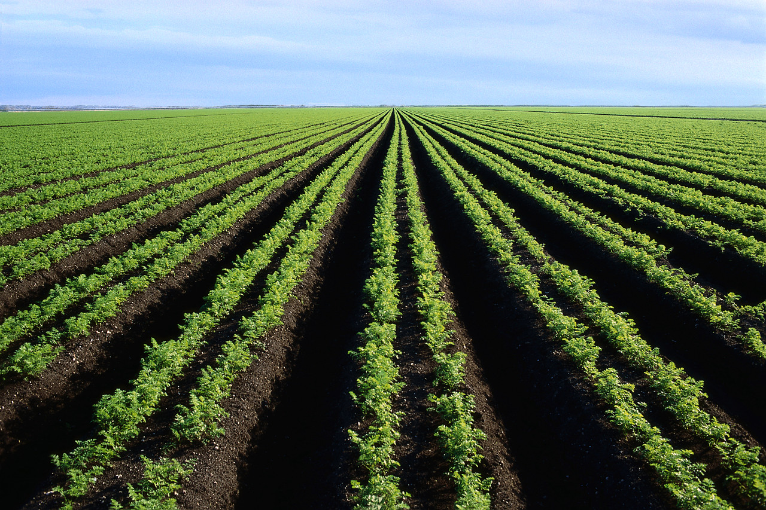
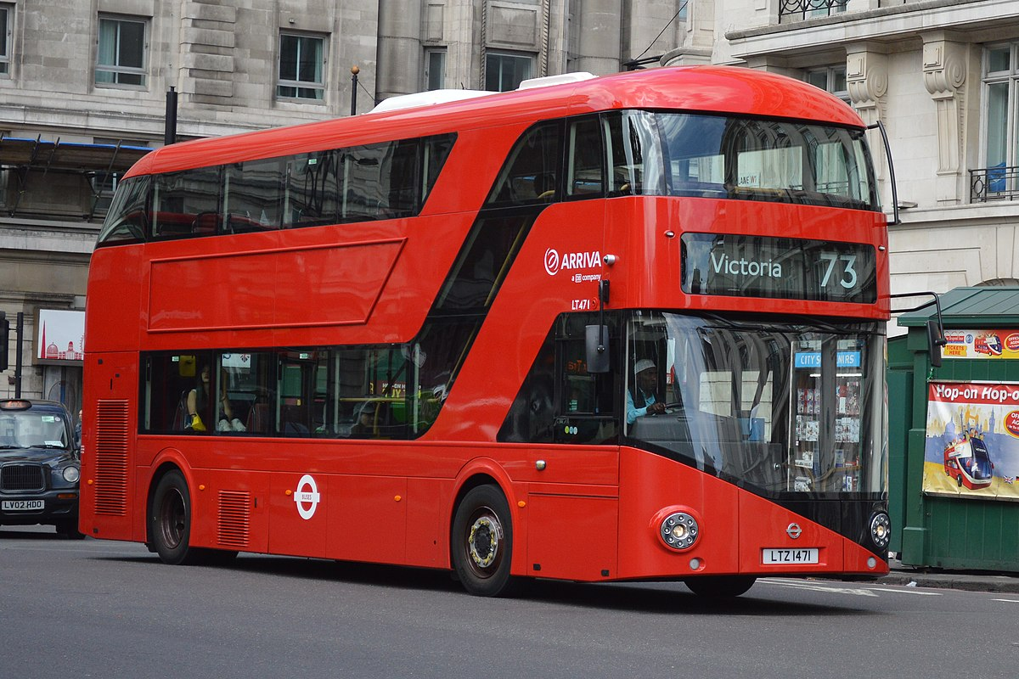
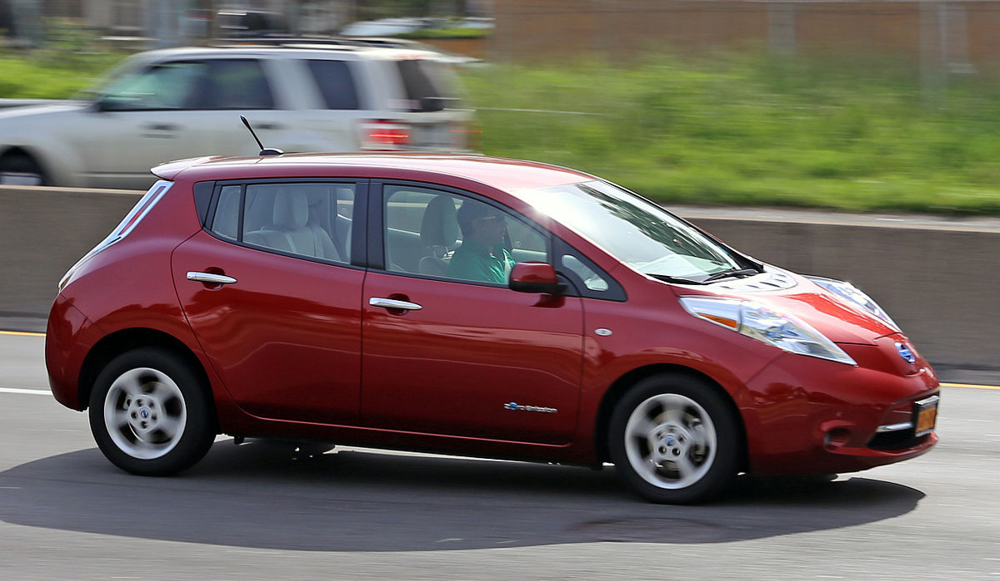
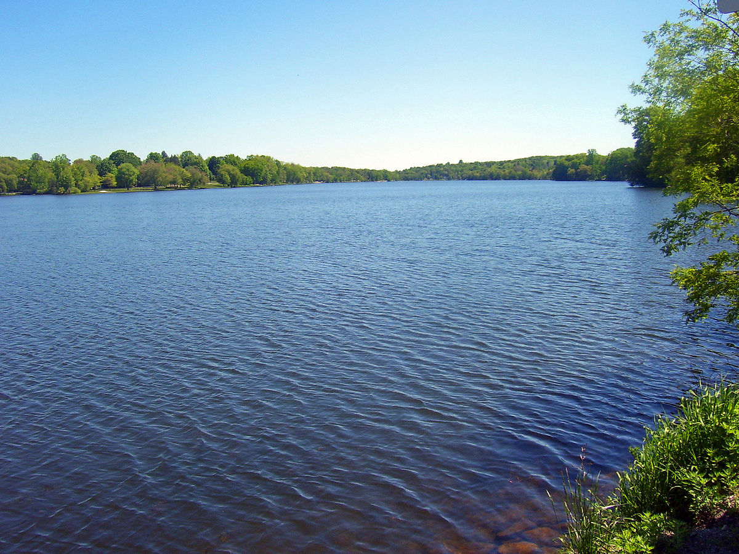
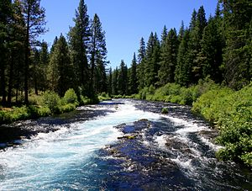
Our Goal
Distinguish between five sets of similar features
Roads and Tracks
Buildings and Misc. Structures
Trees and Crops
Large and Small Vehicles
Standing and Moving Water
Notes:
NH

Slide 3
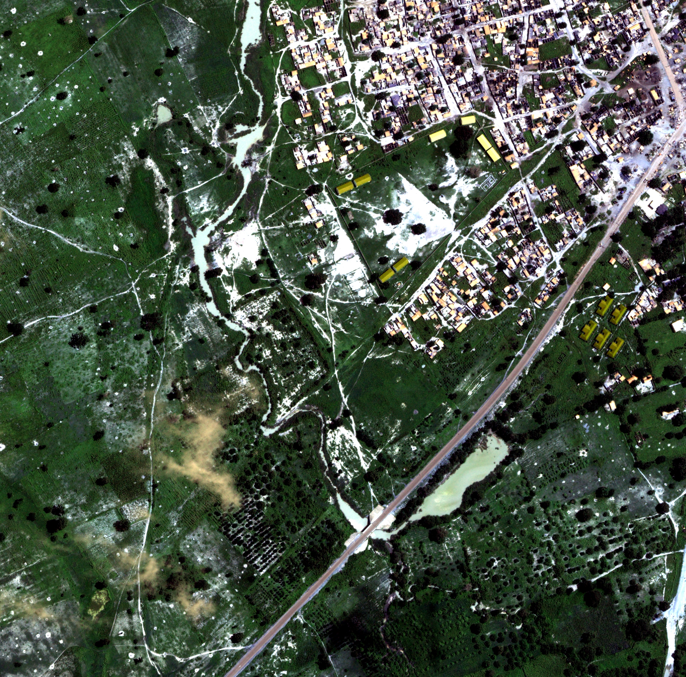
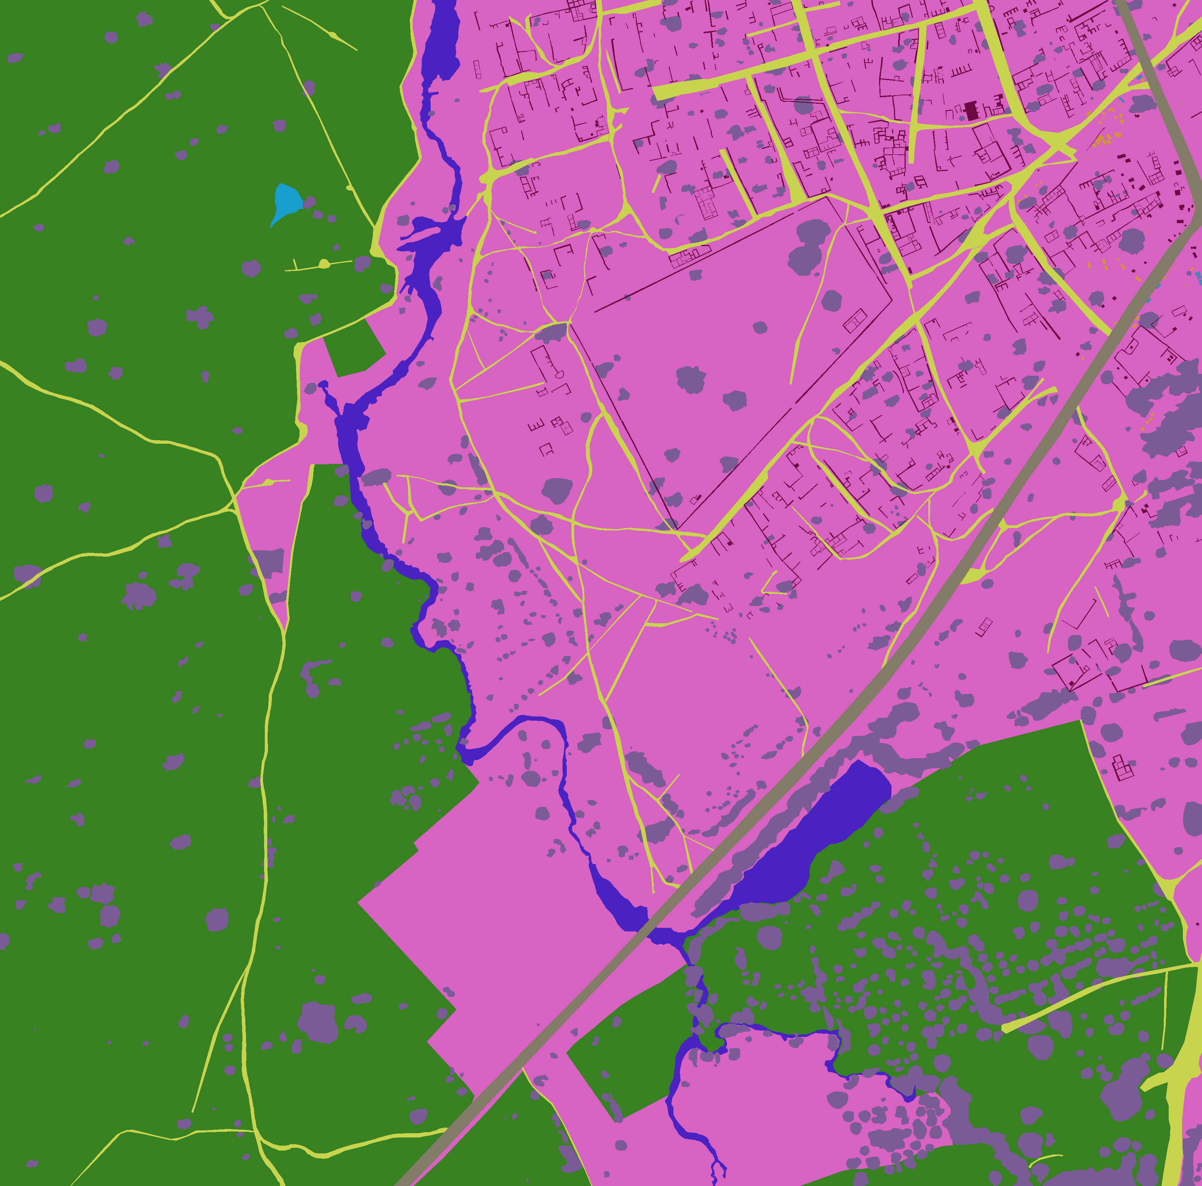
Training an Eye in the Sky Distinguishing similar features in satellite imagery
Notes:
The Verdict: to some extent, yes!

Slide 4
Agenda
What are we trying to detect?
Why we want to use machine learning
Data background
Methodology
Results and conclusions

Slide 5
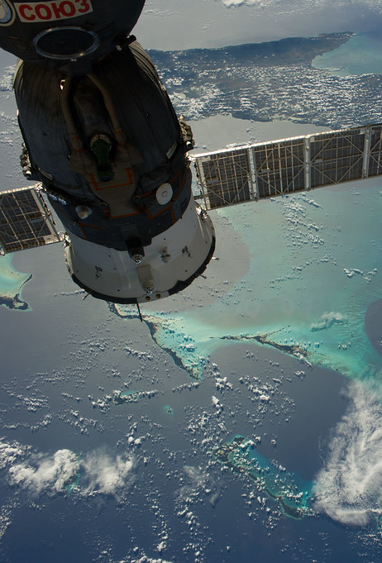

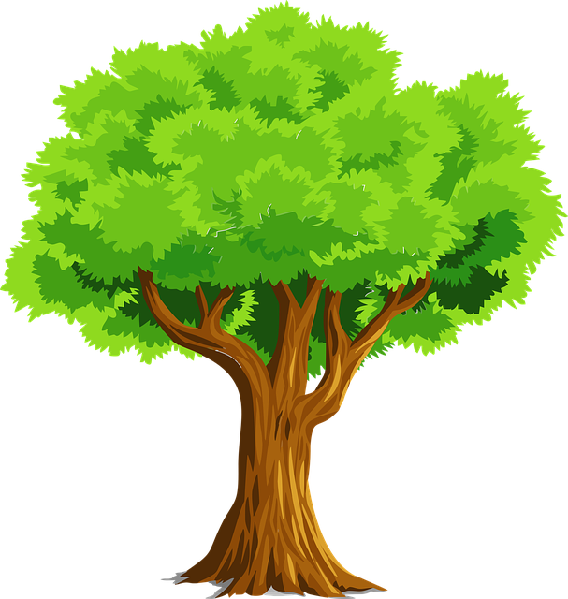

What are we trying to detect?
The United Kingdom’s Defence Science and Technology Laboratory (DSTL) collects large amounts of satellite image data
DSTL created a Kaggle competition in December 2016 that included multi-spectrum satellite images containing key features:
Buildings, Miscellaneous Manmade Structures, Roads, Tracks, Trees, Crops, Waterways, Standing Water, and Vehicles

Slide 6
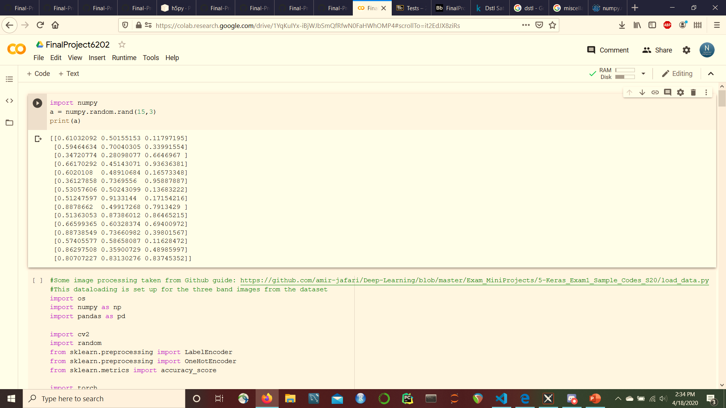
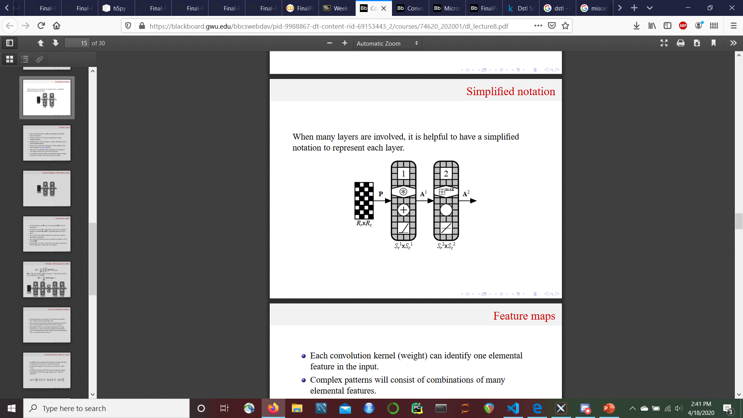
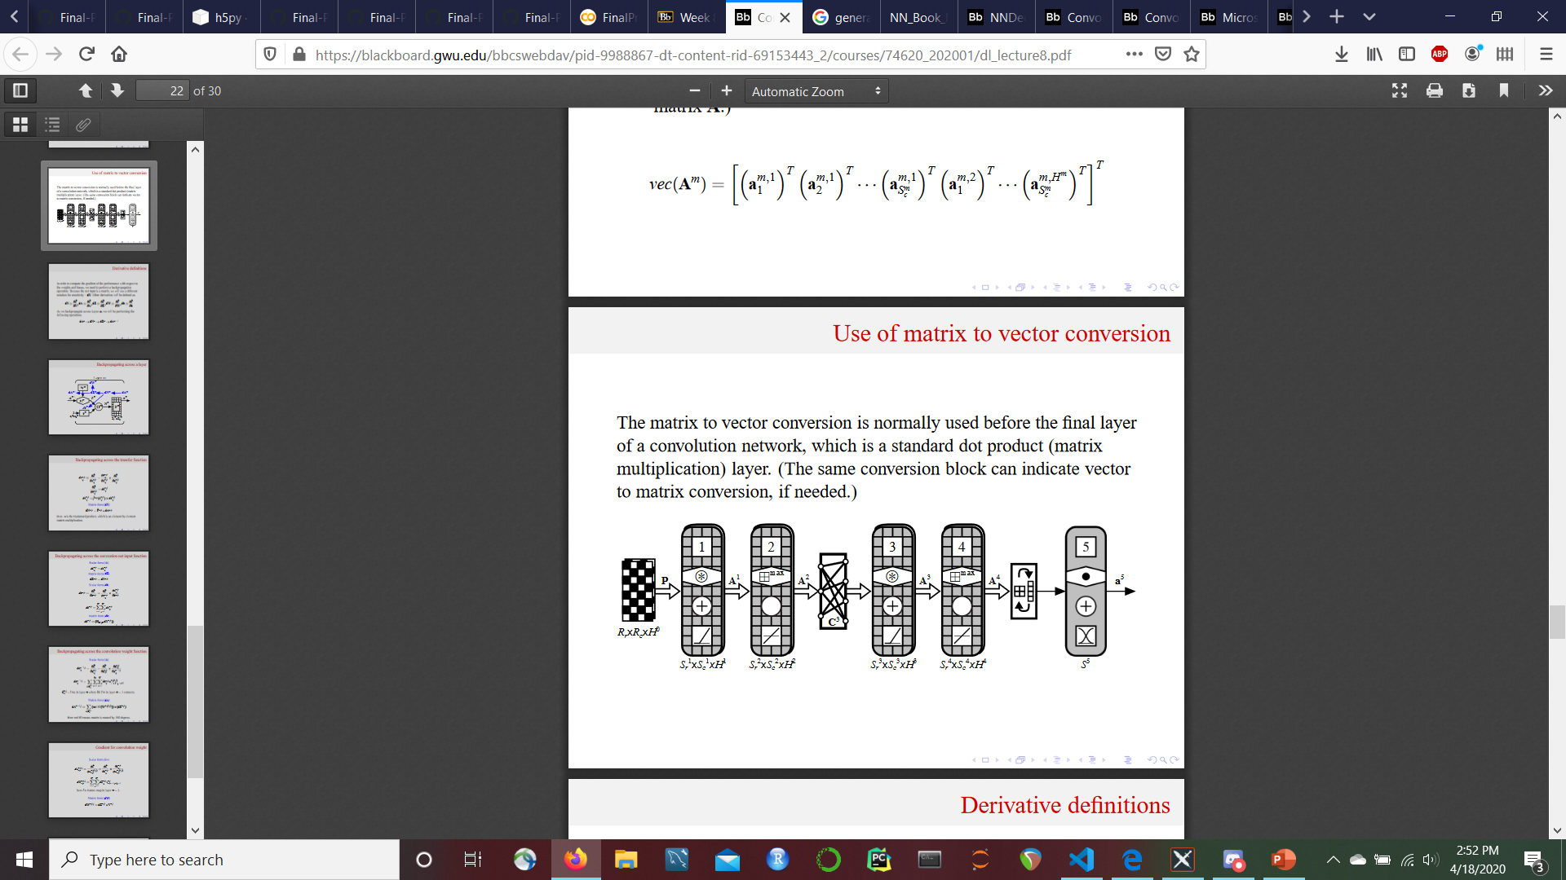
Why we want to use ml
Neural networks are powerful tools for finding the relationships between data and some target output.
In this case, a U-Net (a type of CNN built for image segmentation) is a good network for our data.
3
T
3
Convolution →
Upsampling
No Dense Layers

Slide 7
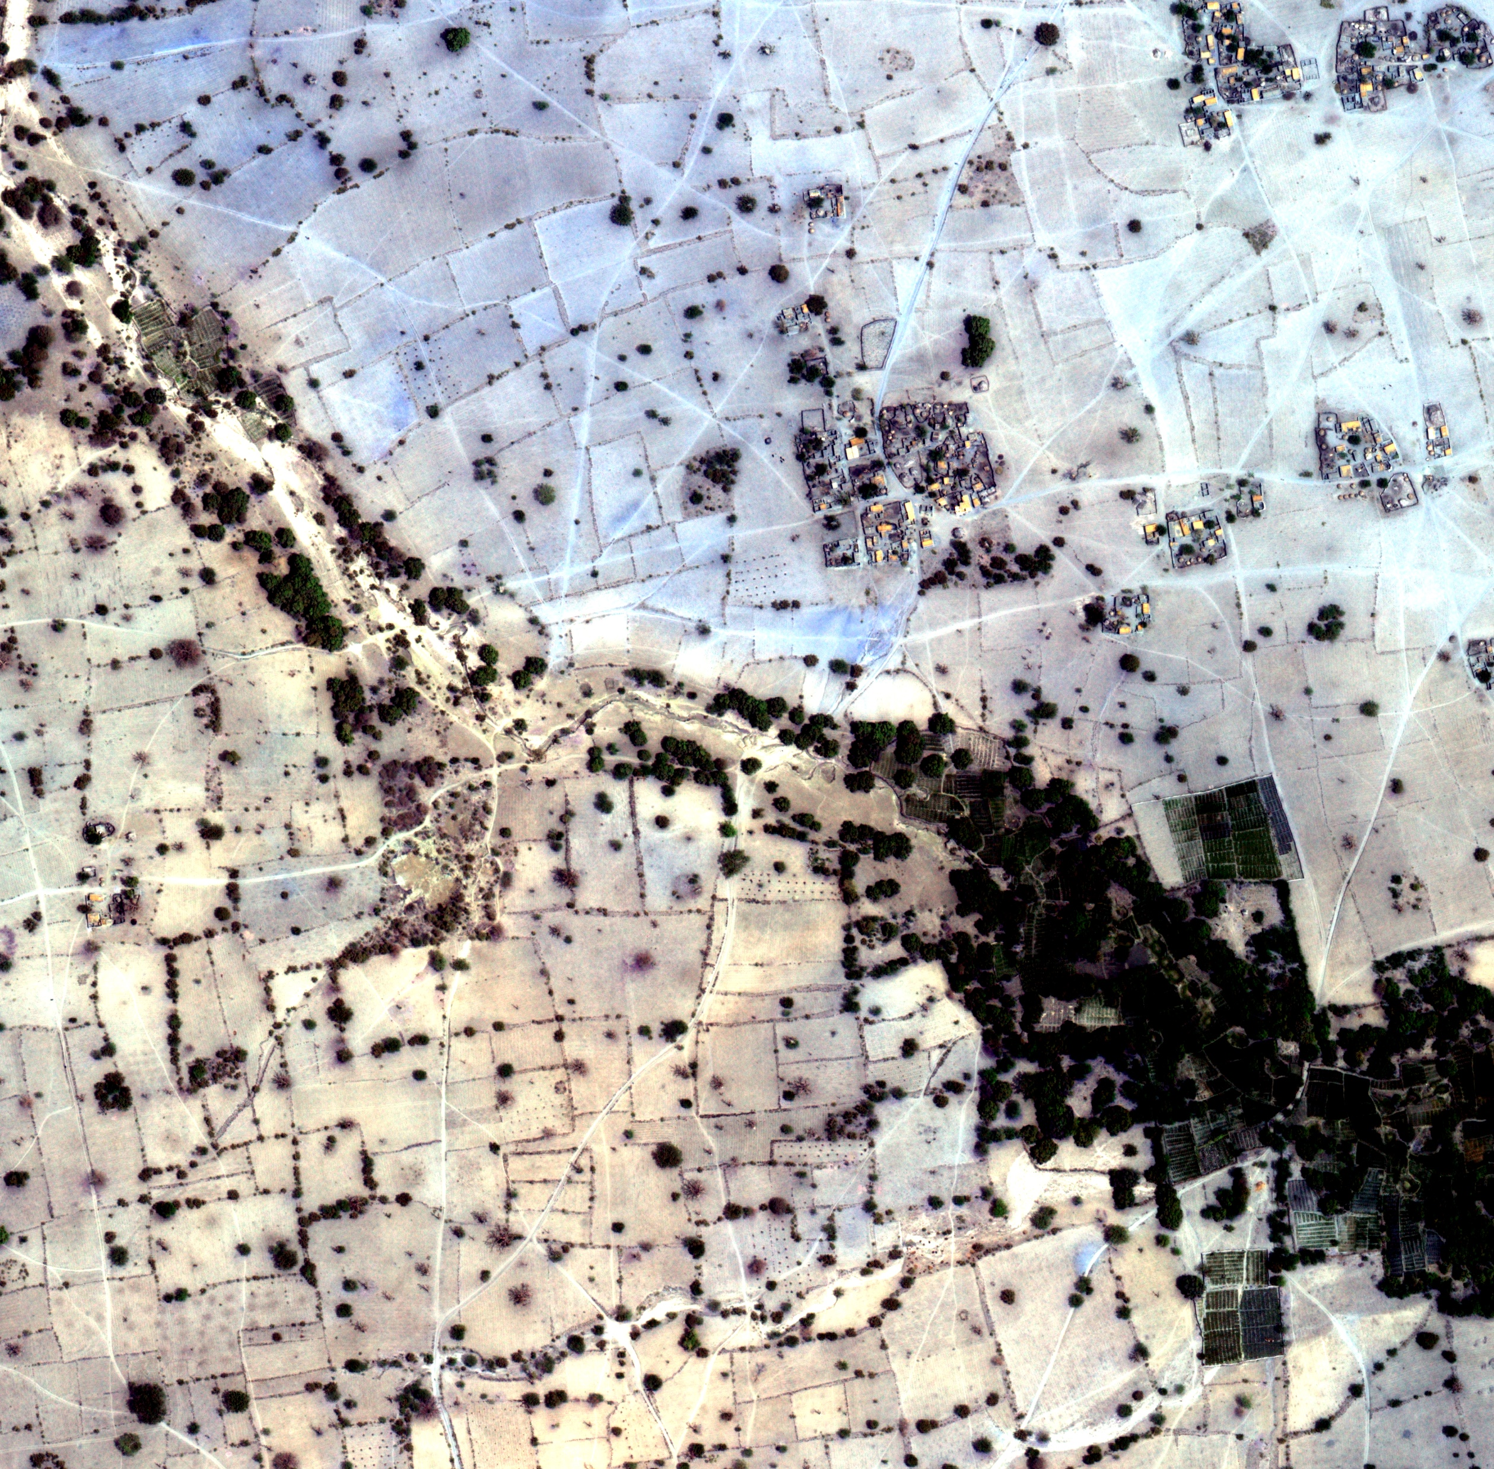
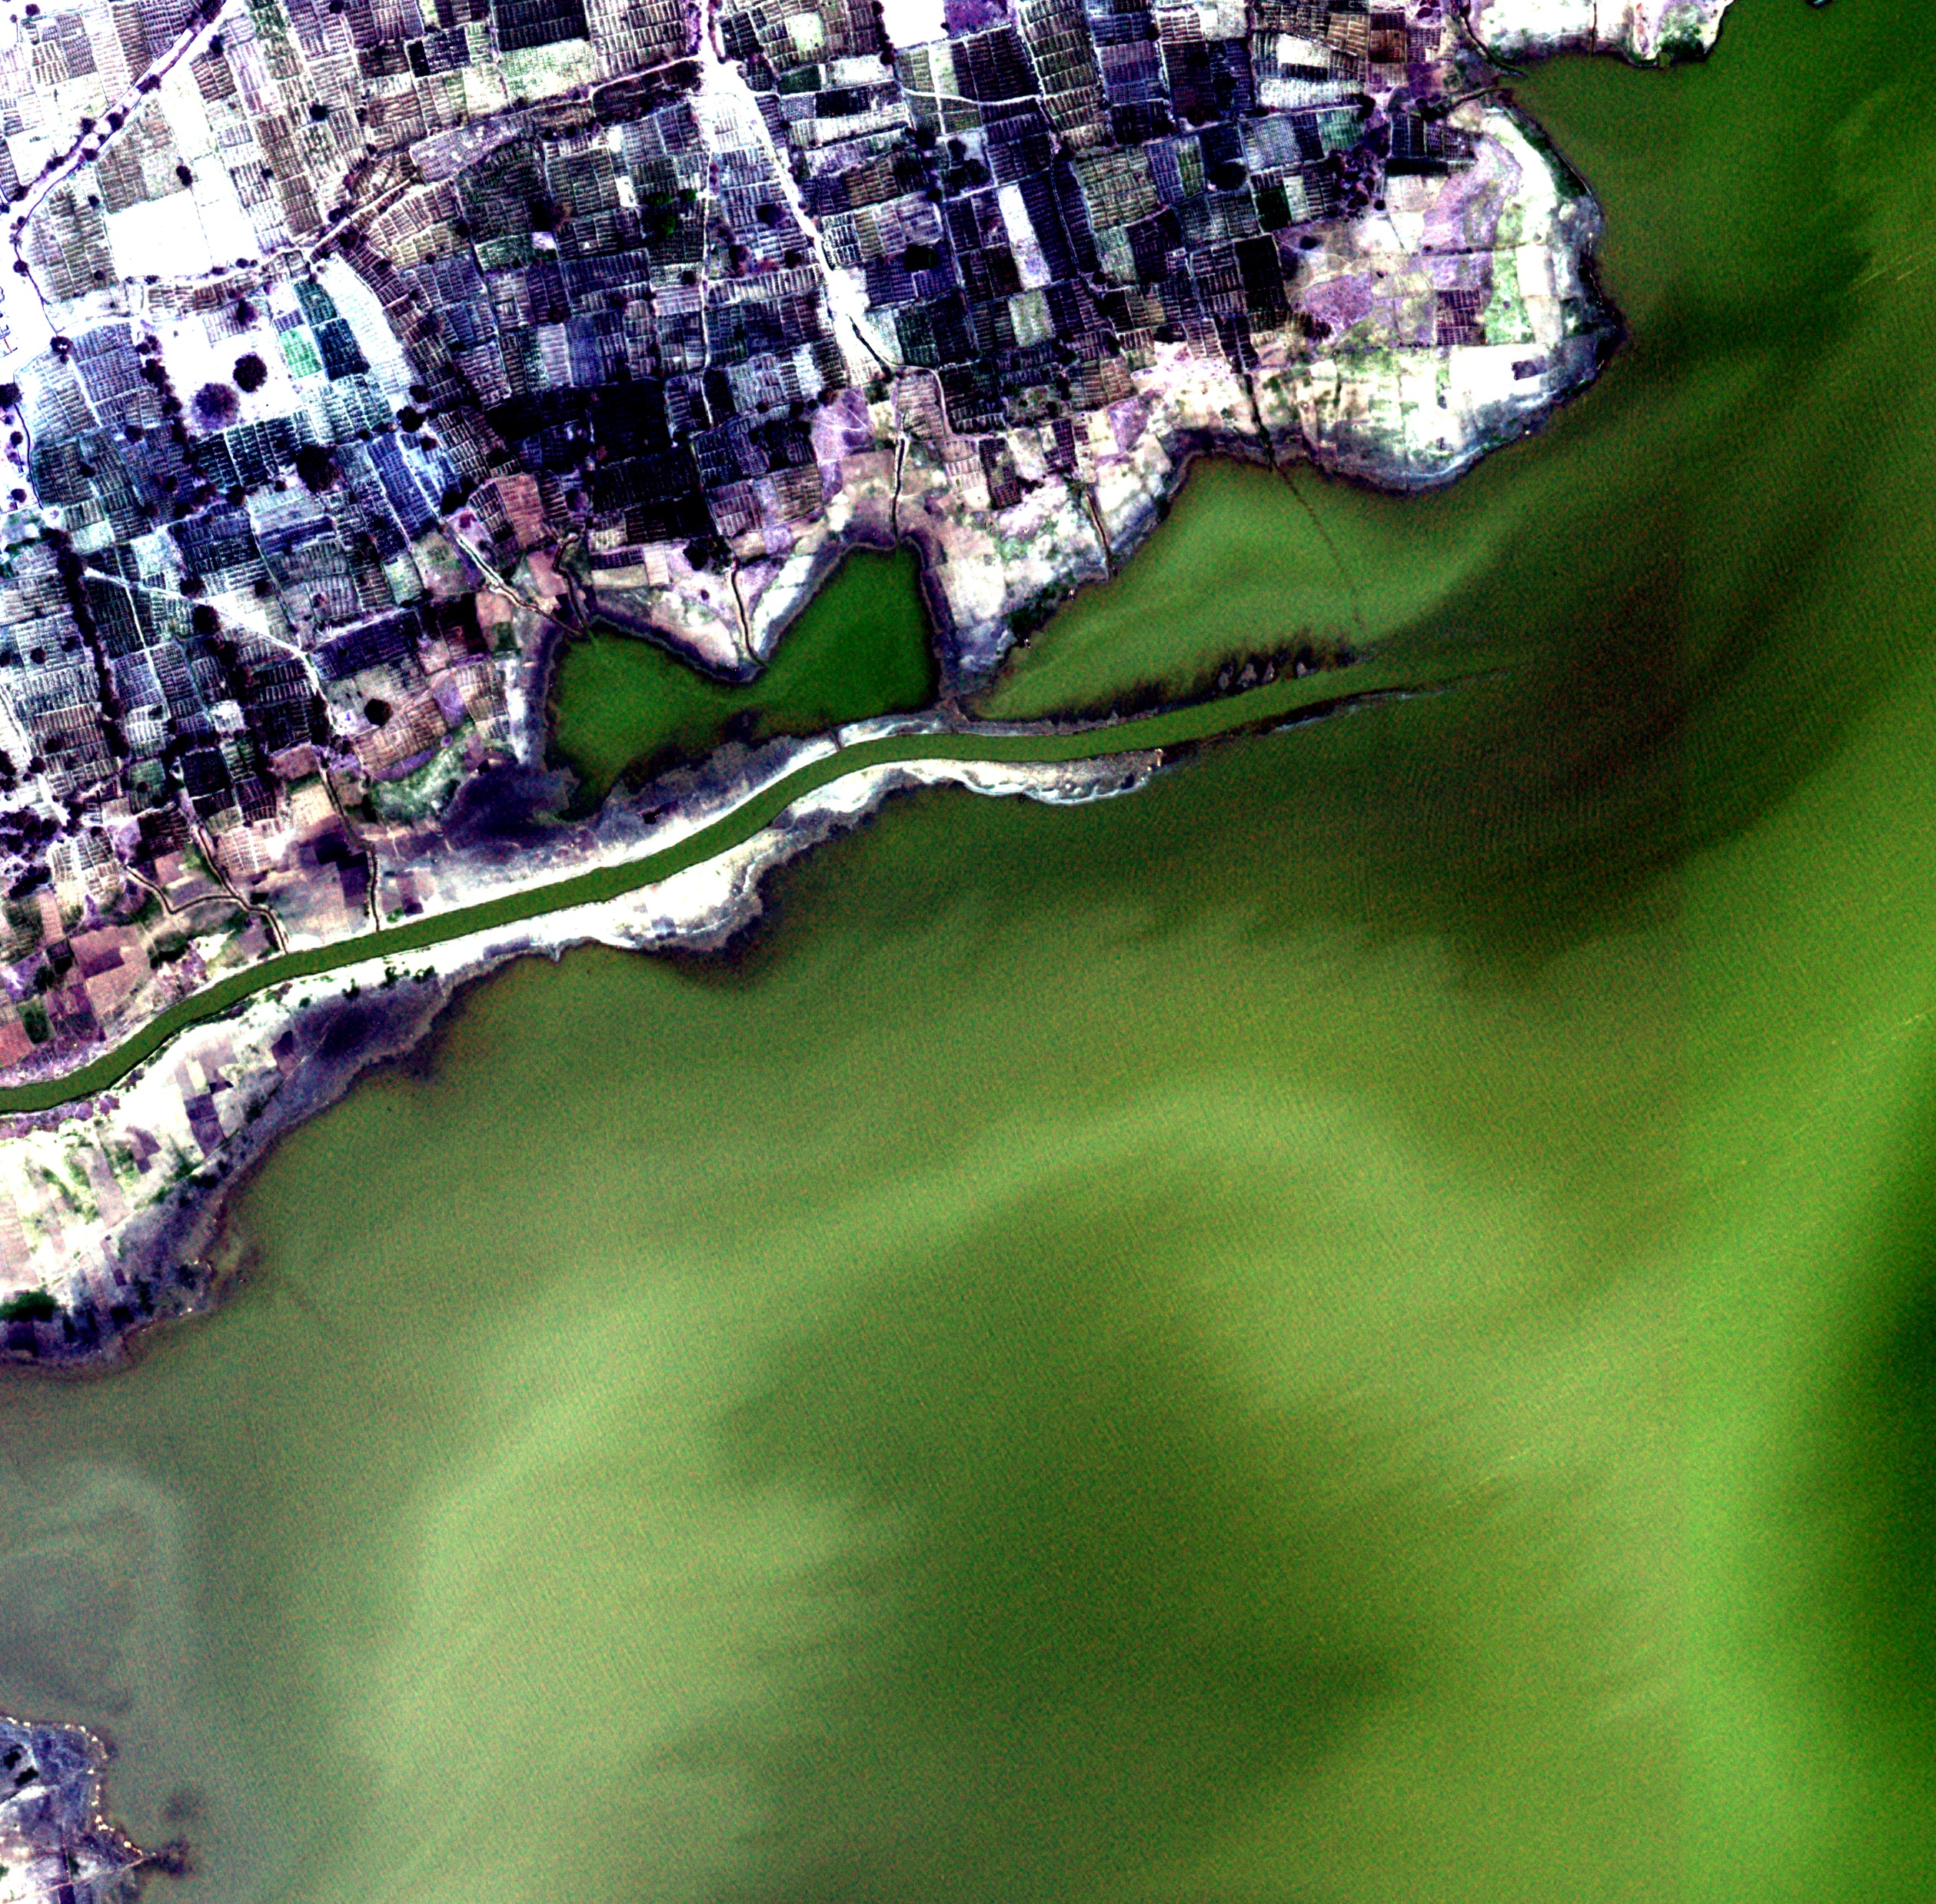
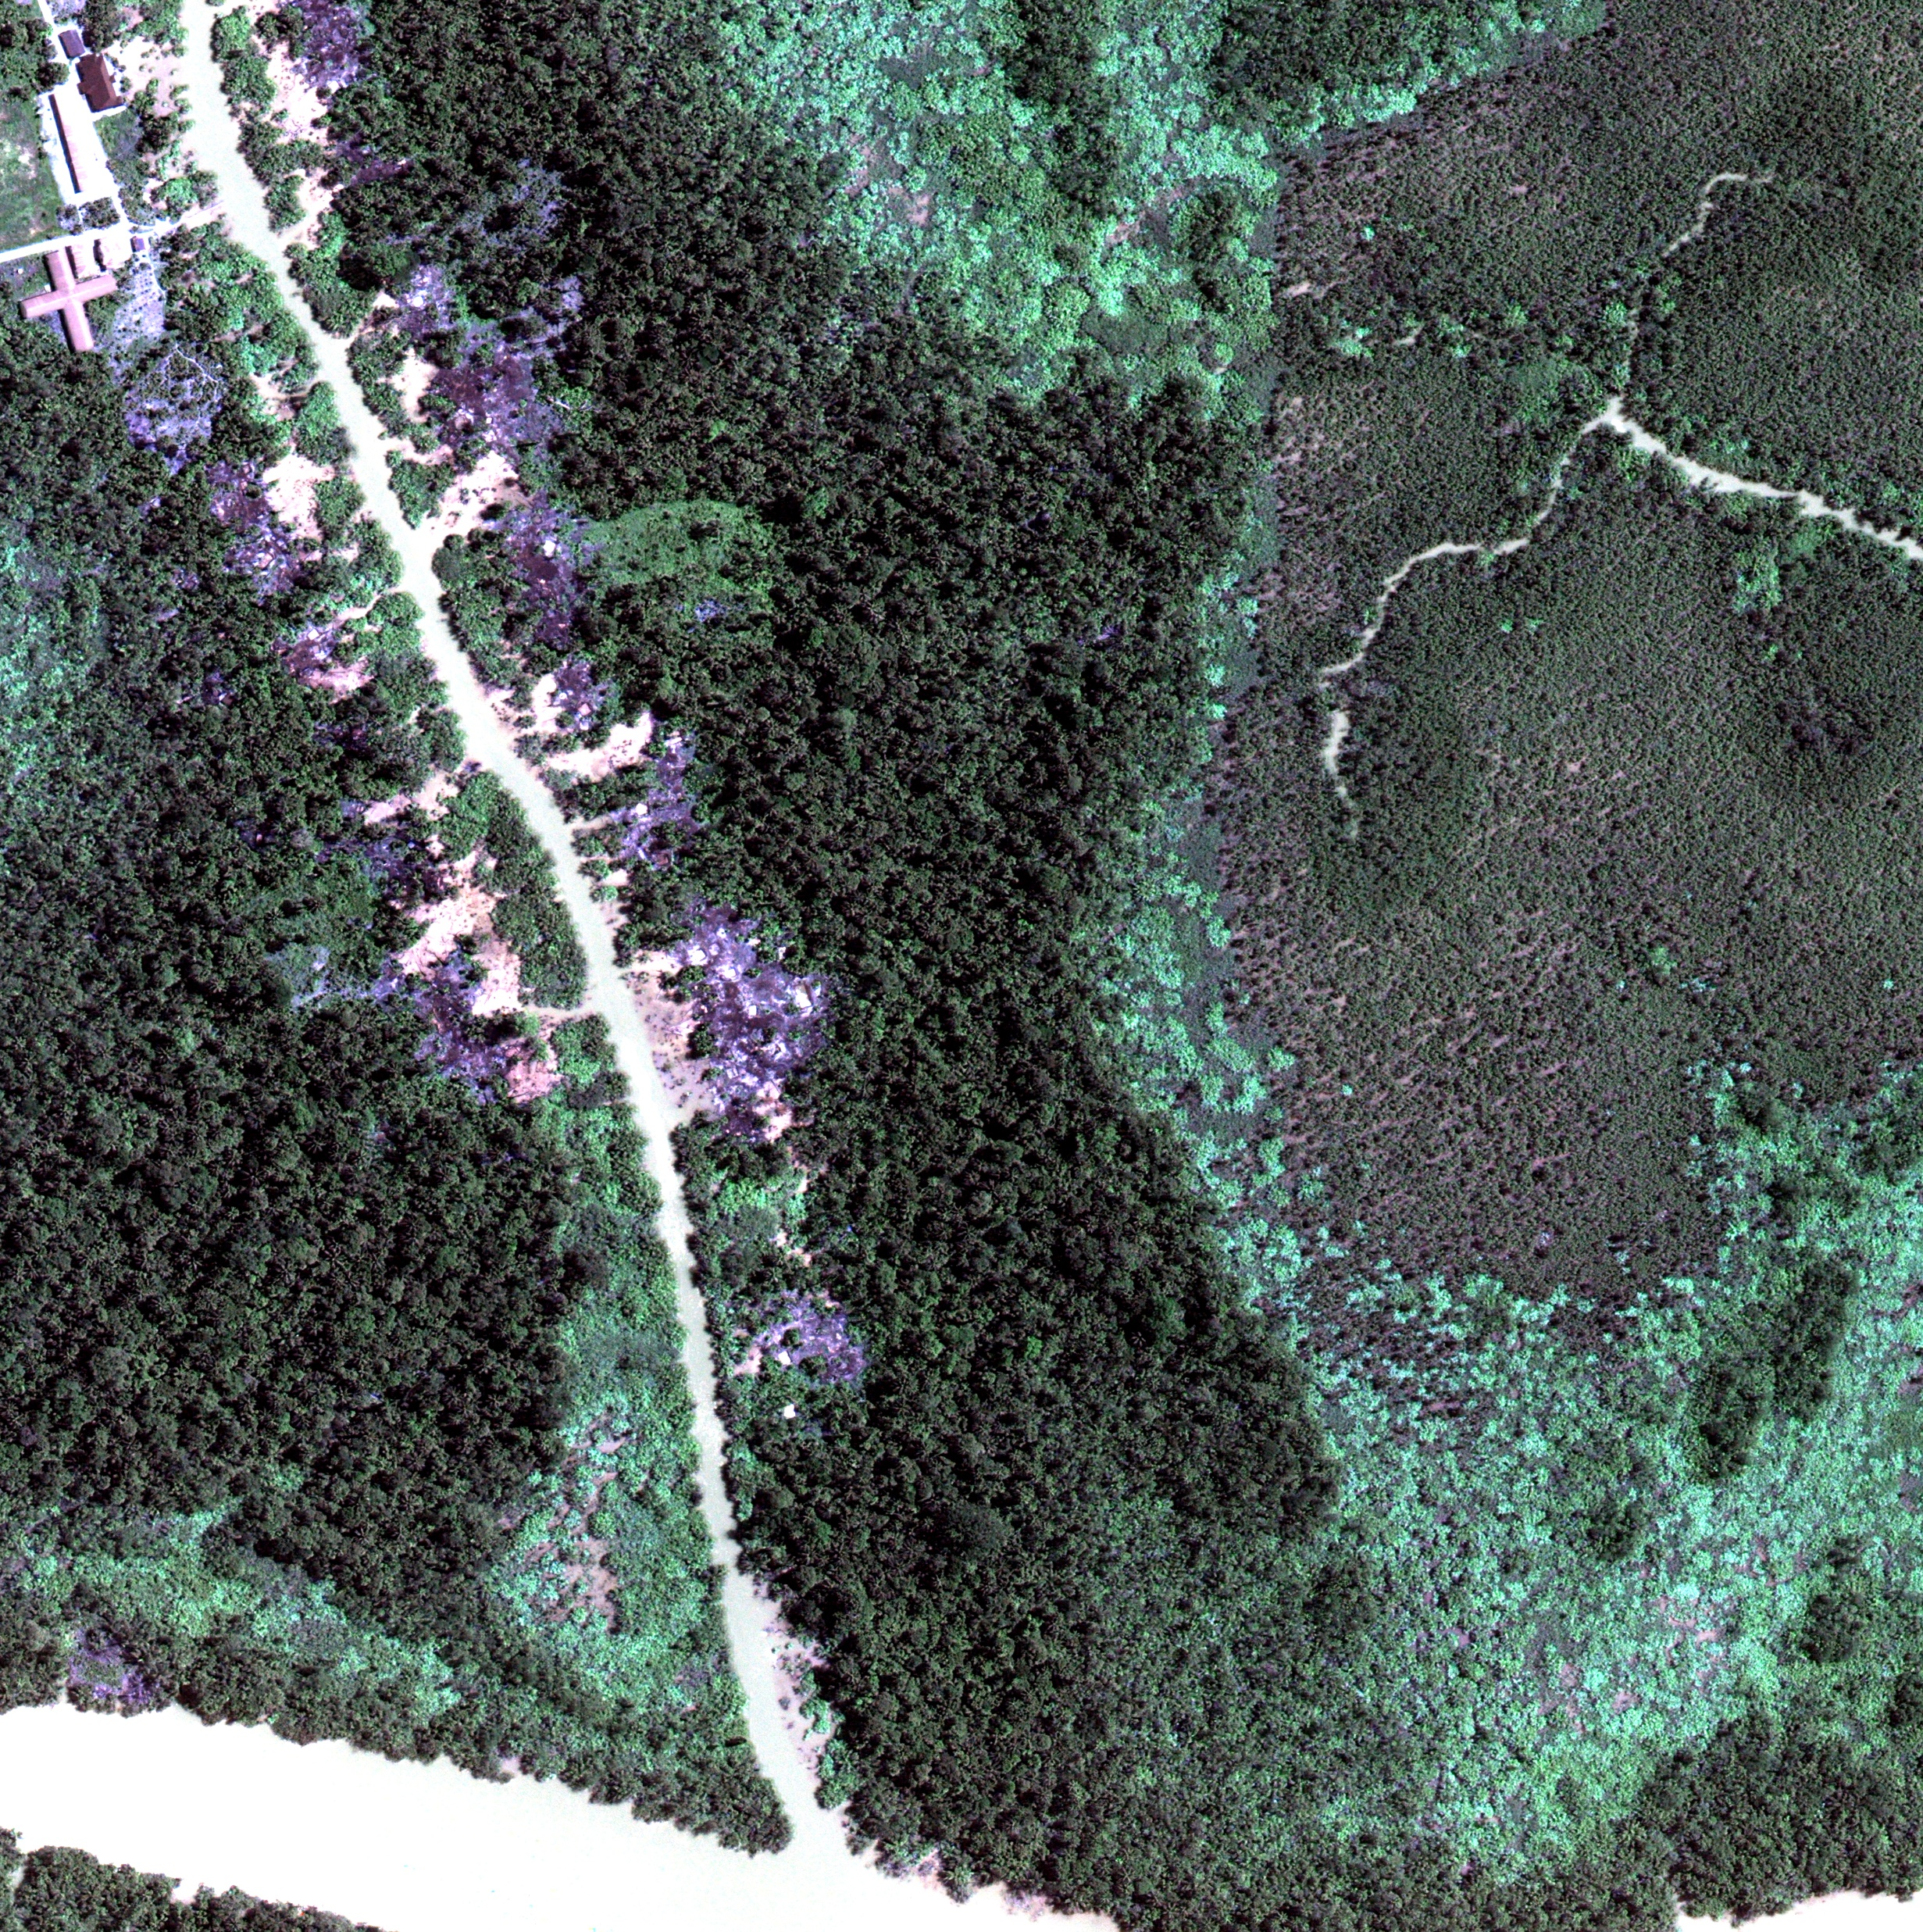
Data Background
The DSTL dataset contains 150 3-band and 16-band satellite images of various locations in the United Kingdom
Each training image has labeled polygon coordinates that correspond to a target – 10 targets in total.
Since some data types were similar (e.g. large and small vehicles) we started preprocessing by grouping together those training sets and masking the images with labeled polygons.

Slide 8
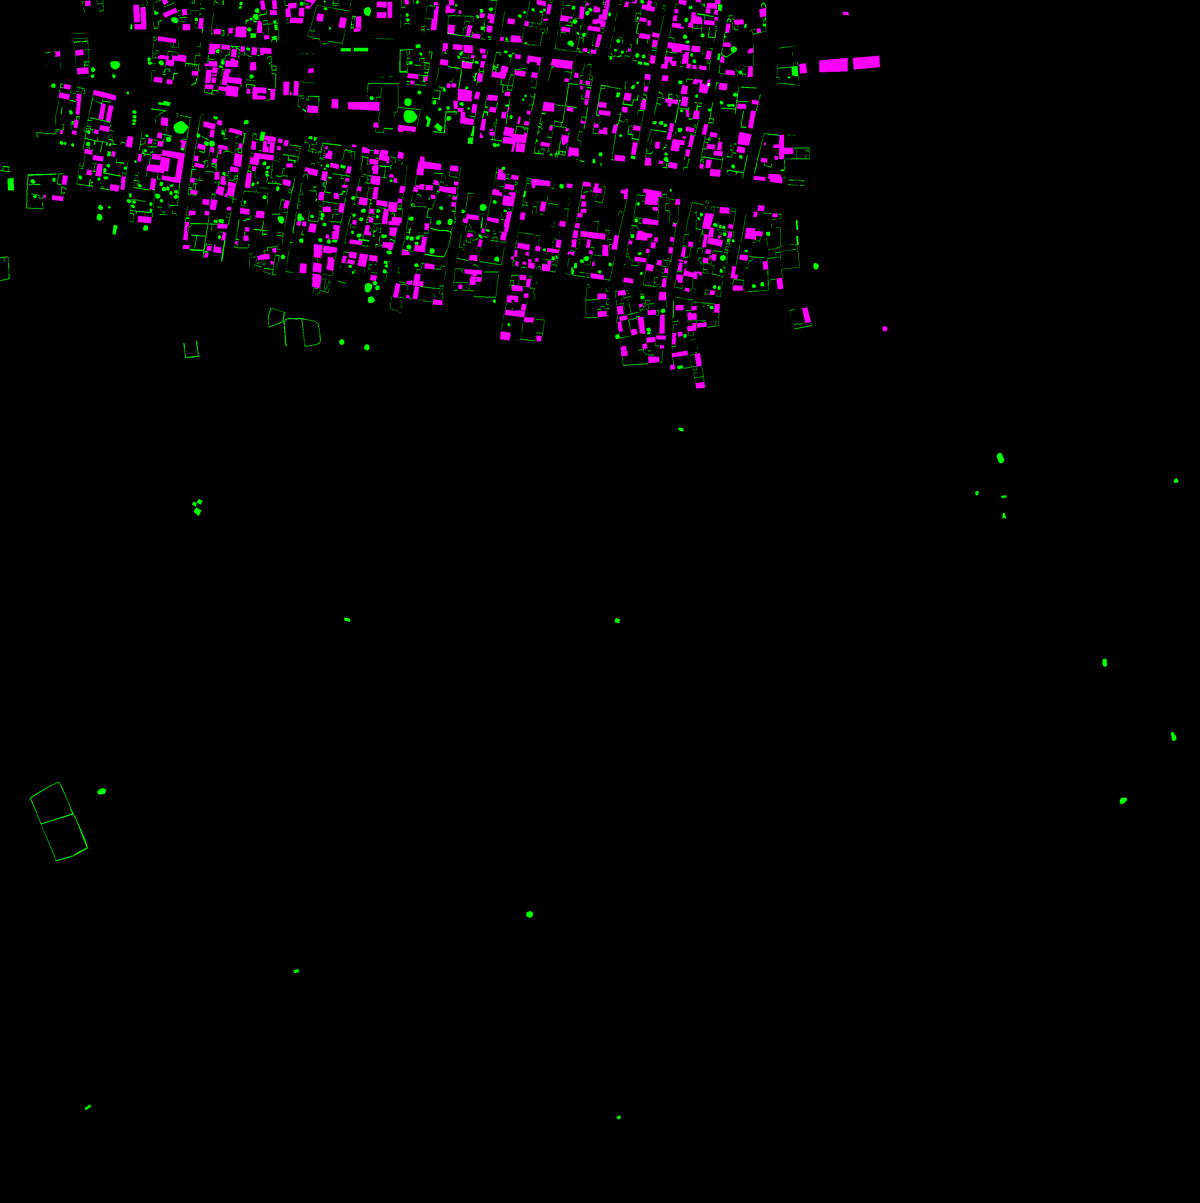
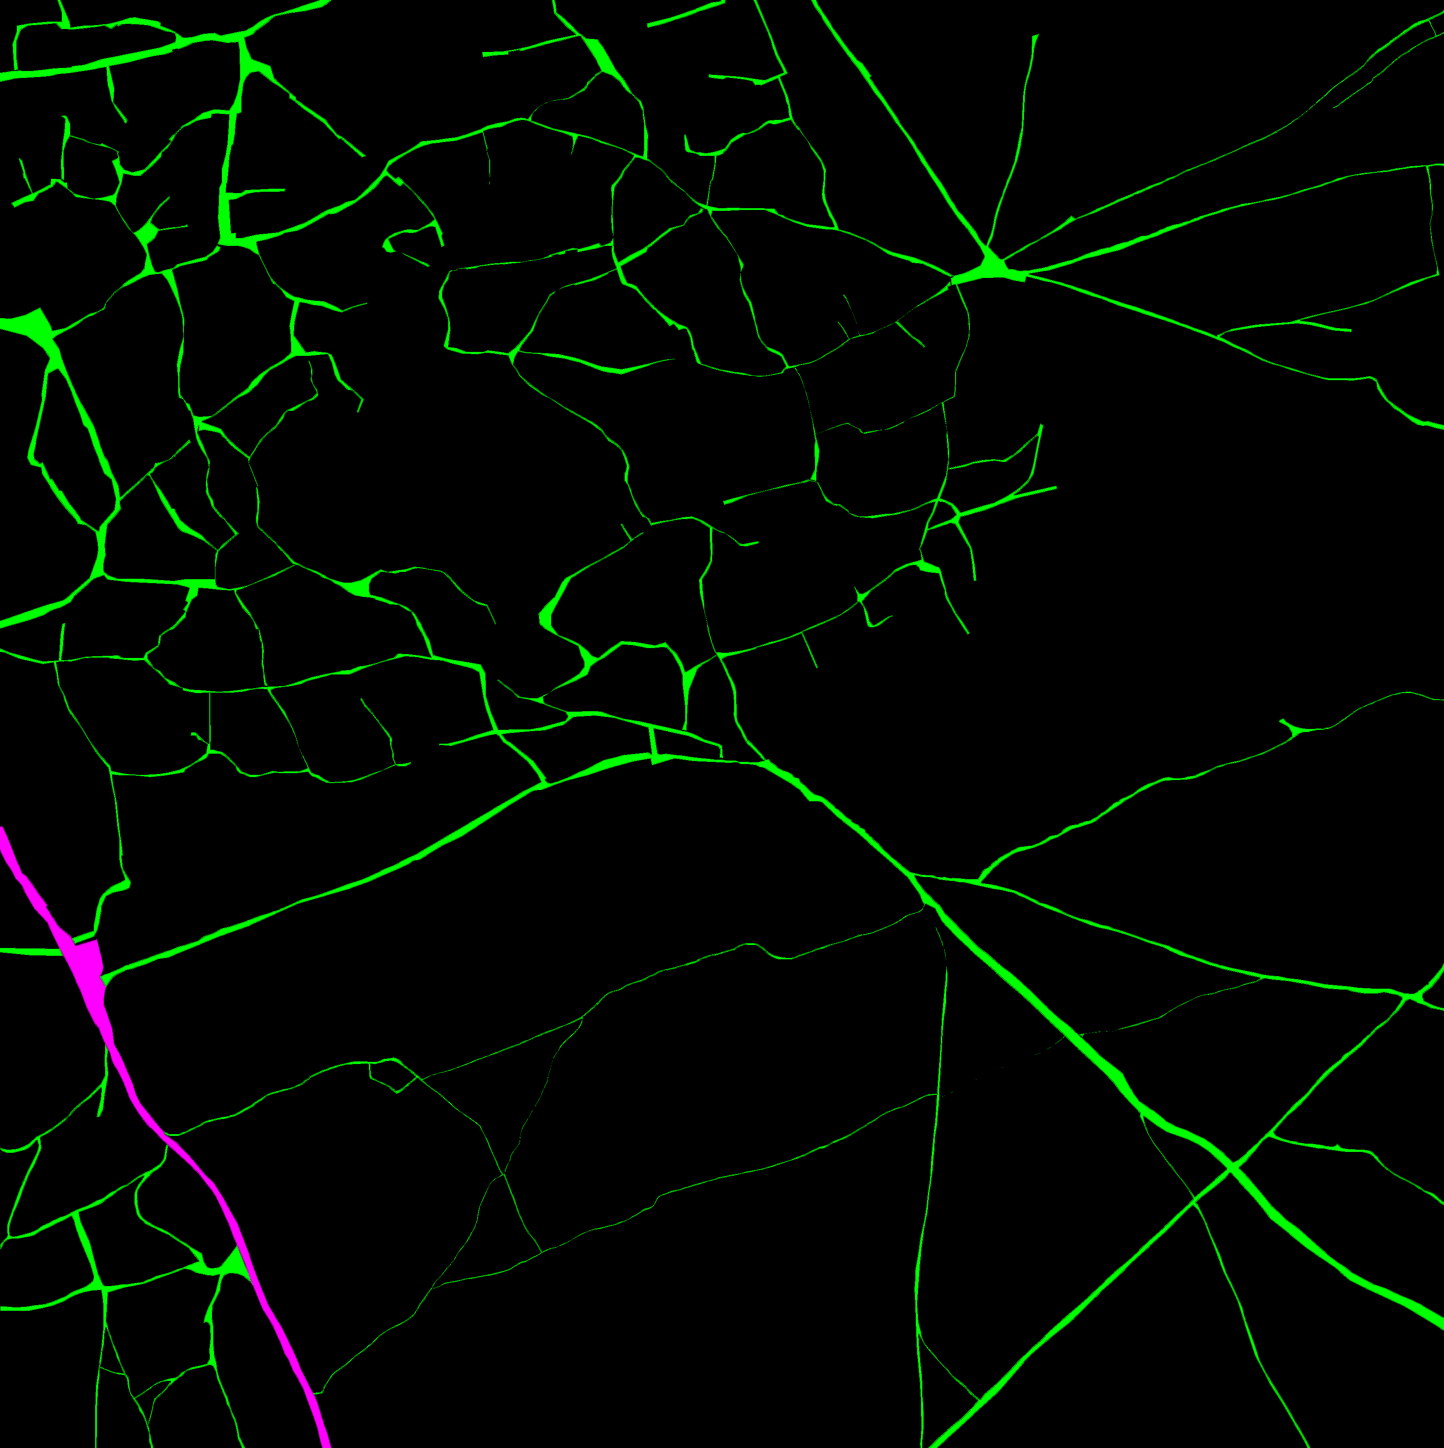
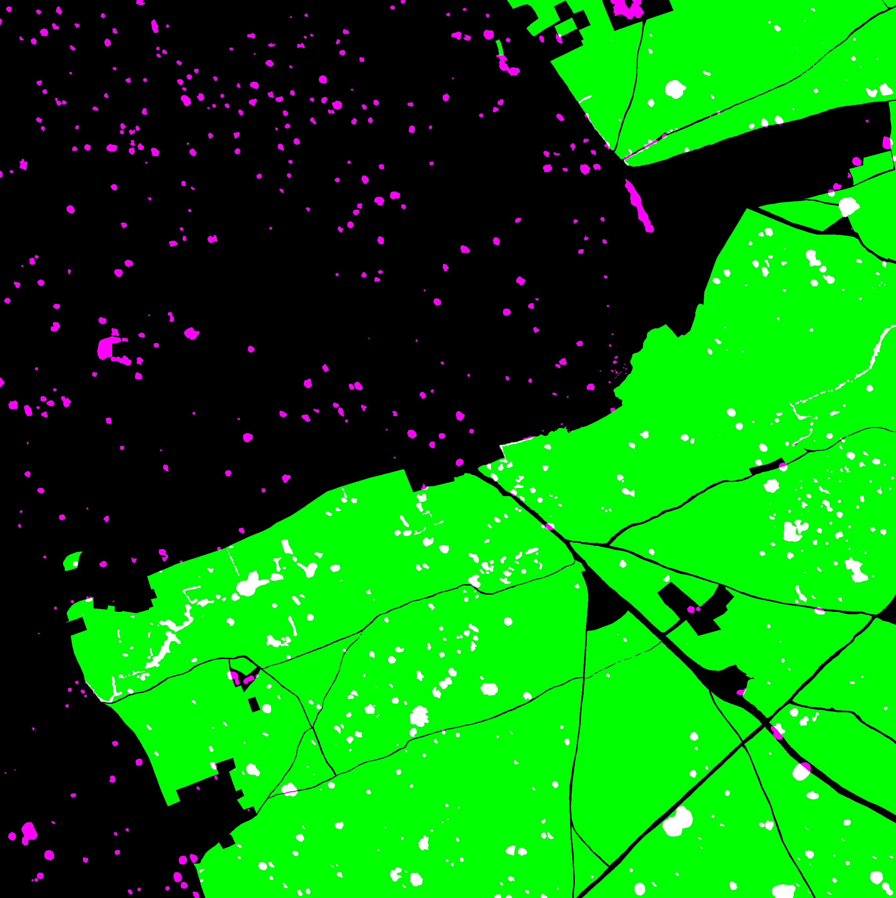
Methodology
After preprocessing, we had five sets of masked training data that had been transposed and could be split into different specialized image segmentation U-Nets.
This data was fed into U-Nets built in the Keras ML library.
A generator within the network randomly splits the input images into smaller chunks via cropping for better training.
The U-Net had 10 convolutional layers and included normalization, Exponential Linear Unit (ELU) activations, pooling, and cropping to achieve better performance.
Notes:
U-NET - slightly modified from the original version created by the University of Freiburg, Germany.
For each section of train cached data
Batch size: 128
Epochs: 50

Slide 9
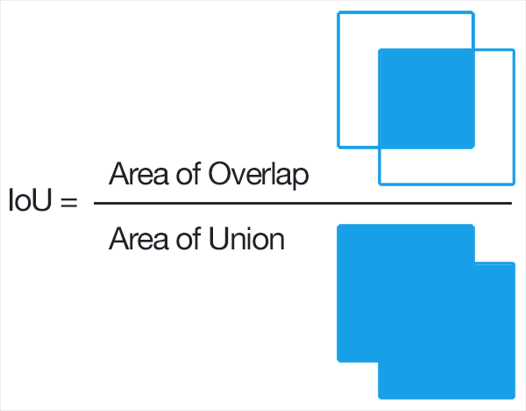
Methodology
The Jaccard index was our performance metric and it is a statistical measure of the similarity between sample sets.
After training each of the U-Net feature models, they could be merged to predict the presence of each of our target classes.
Pytorch was also tested as a framework, but the performance of the Keras models were able to achieve our goals.
Image from Wikipedia

Slide 10
Results and Conclusions
Type of Feature Detection | Training Jaccard Index | Test Jaccard Index
Roads and Tracks | 0.47 | 0.40
Buildings and Misc. Manmade Structures | 0.54 | 0.49
Trees and Crops | 0.55 | 0.48
Large and Small Vehicles | 0.26 | 0.11
Standing and Moving Water | 0.21 | 0.04
Some features were easier to distinguish than others, but this is consistent with existing research on this dataset.
These results could also be consistent with the scores on the leaderboard.
Notes:
XY

Slide 11
Results and Conclusions
Example Raw image of 6100_2_3 in the training set (left), mask generated from labeled polygon (middle) and segmented image predicted (right)

Slide 12
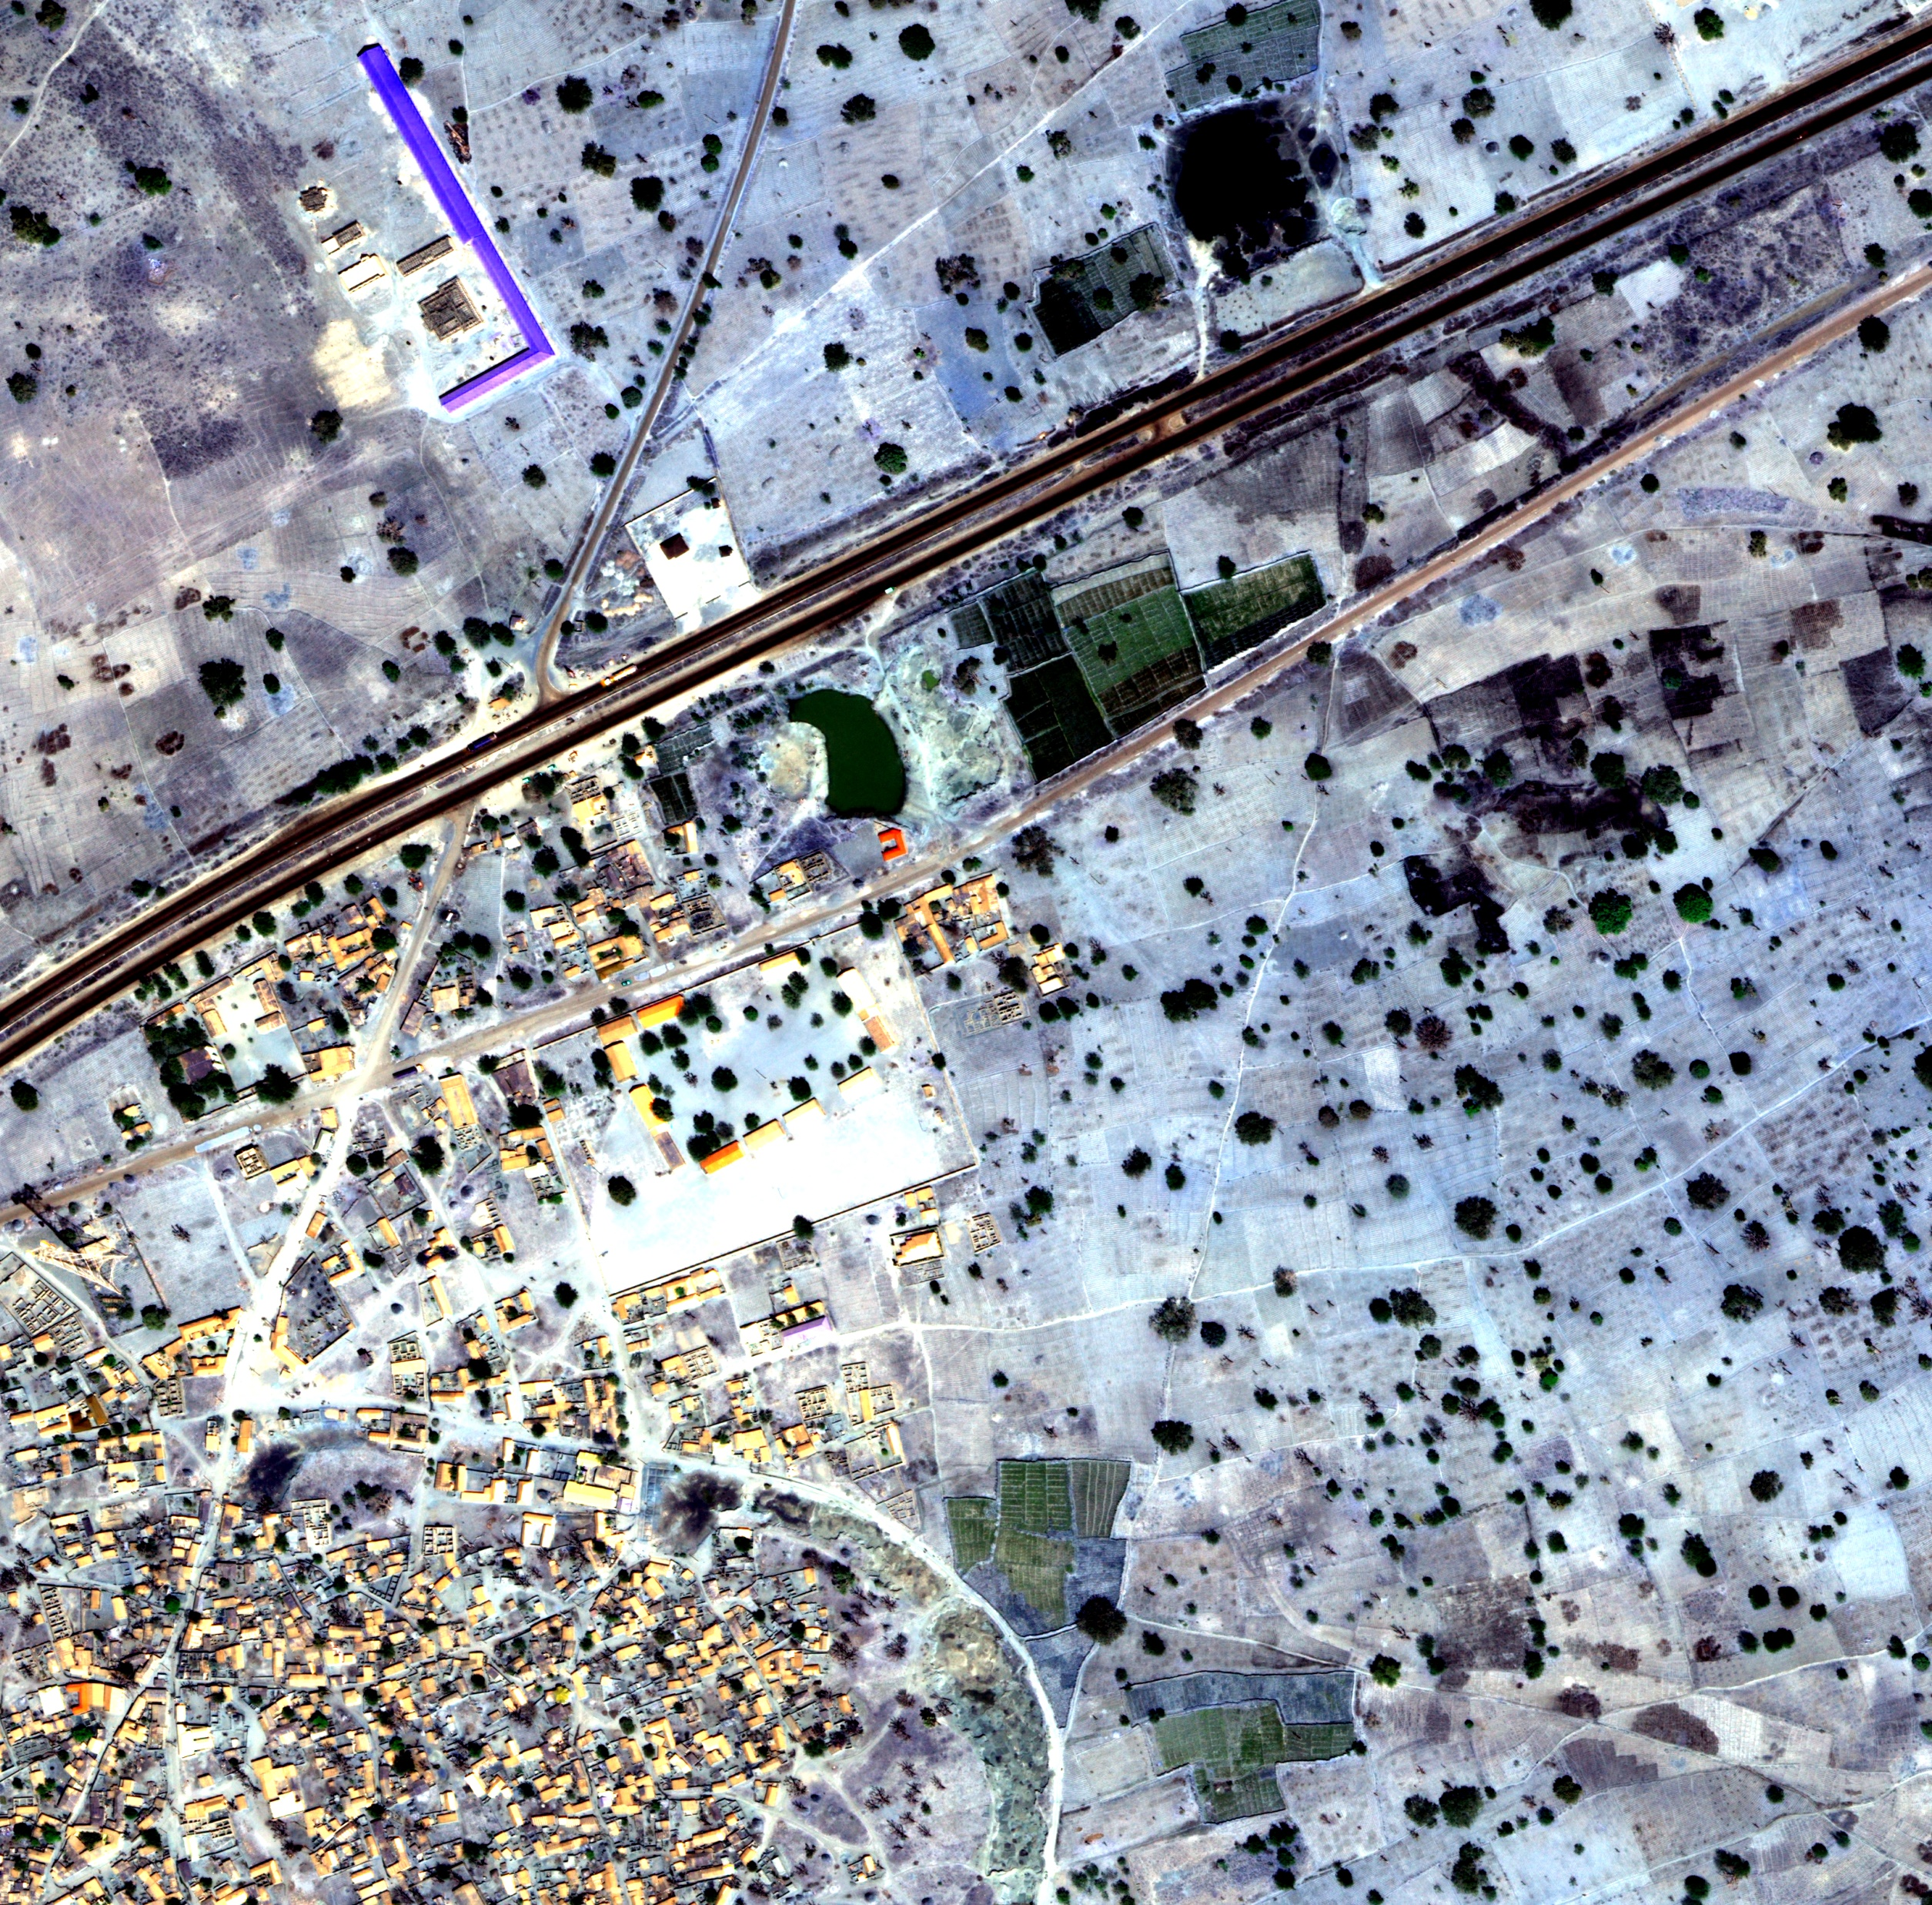
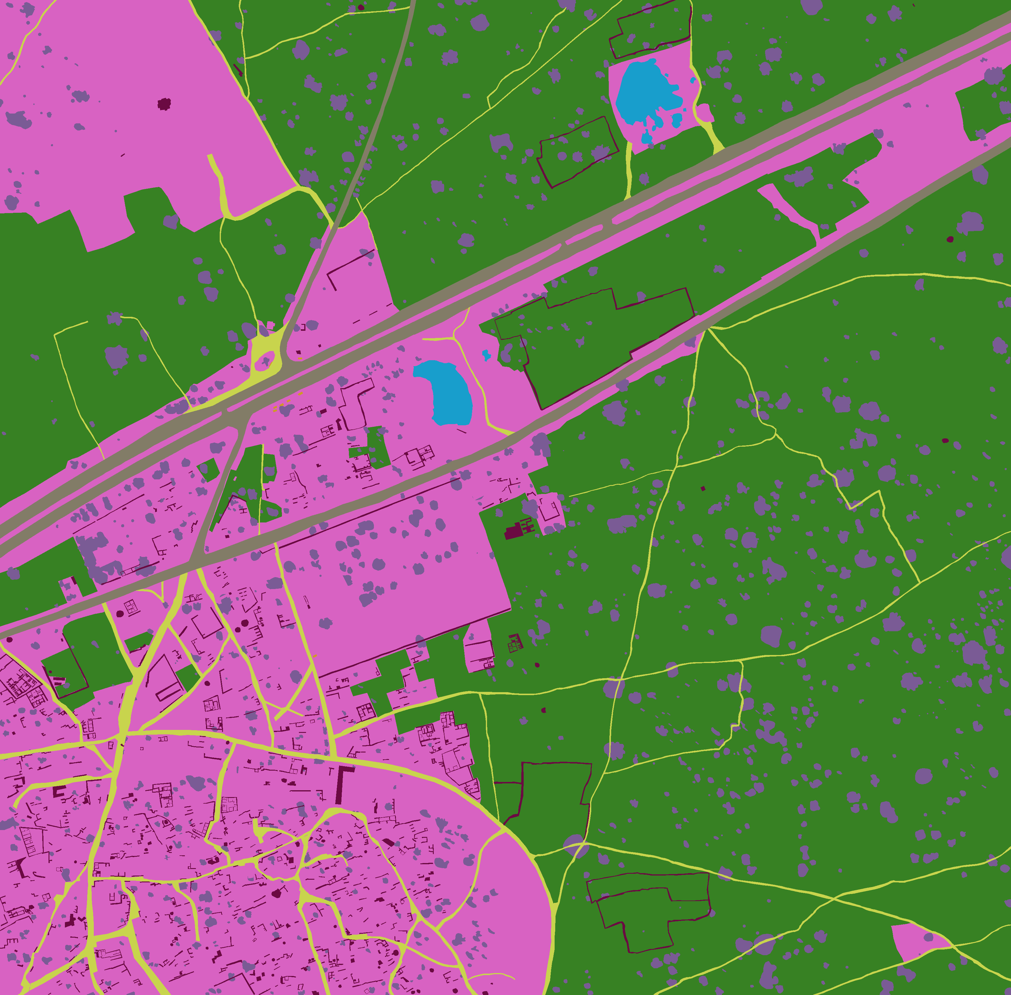
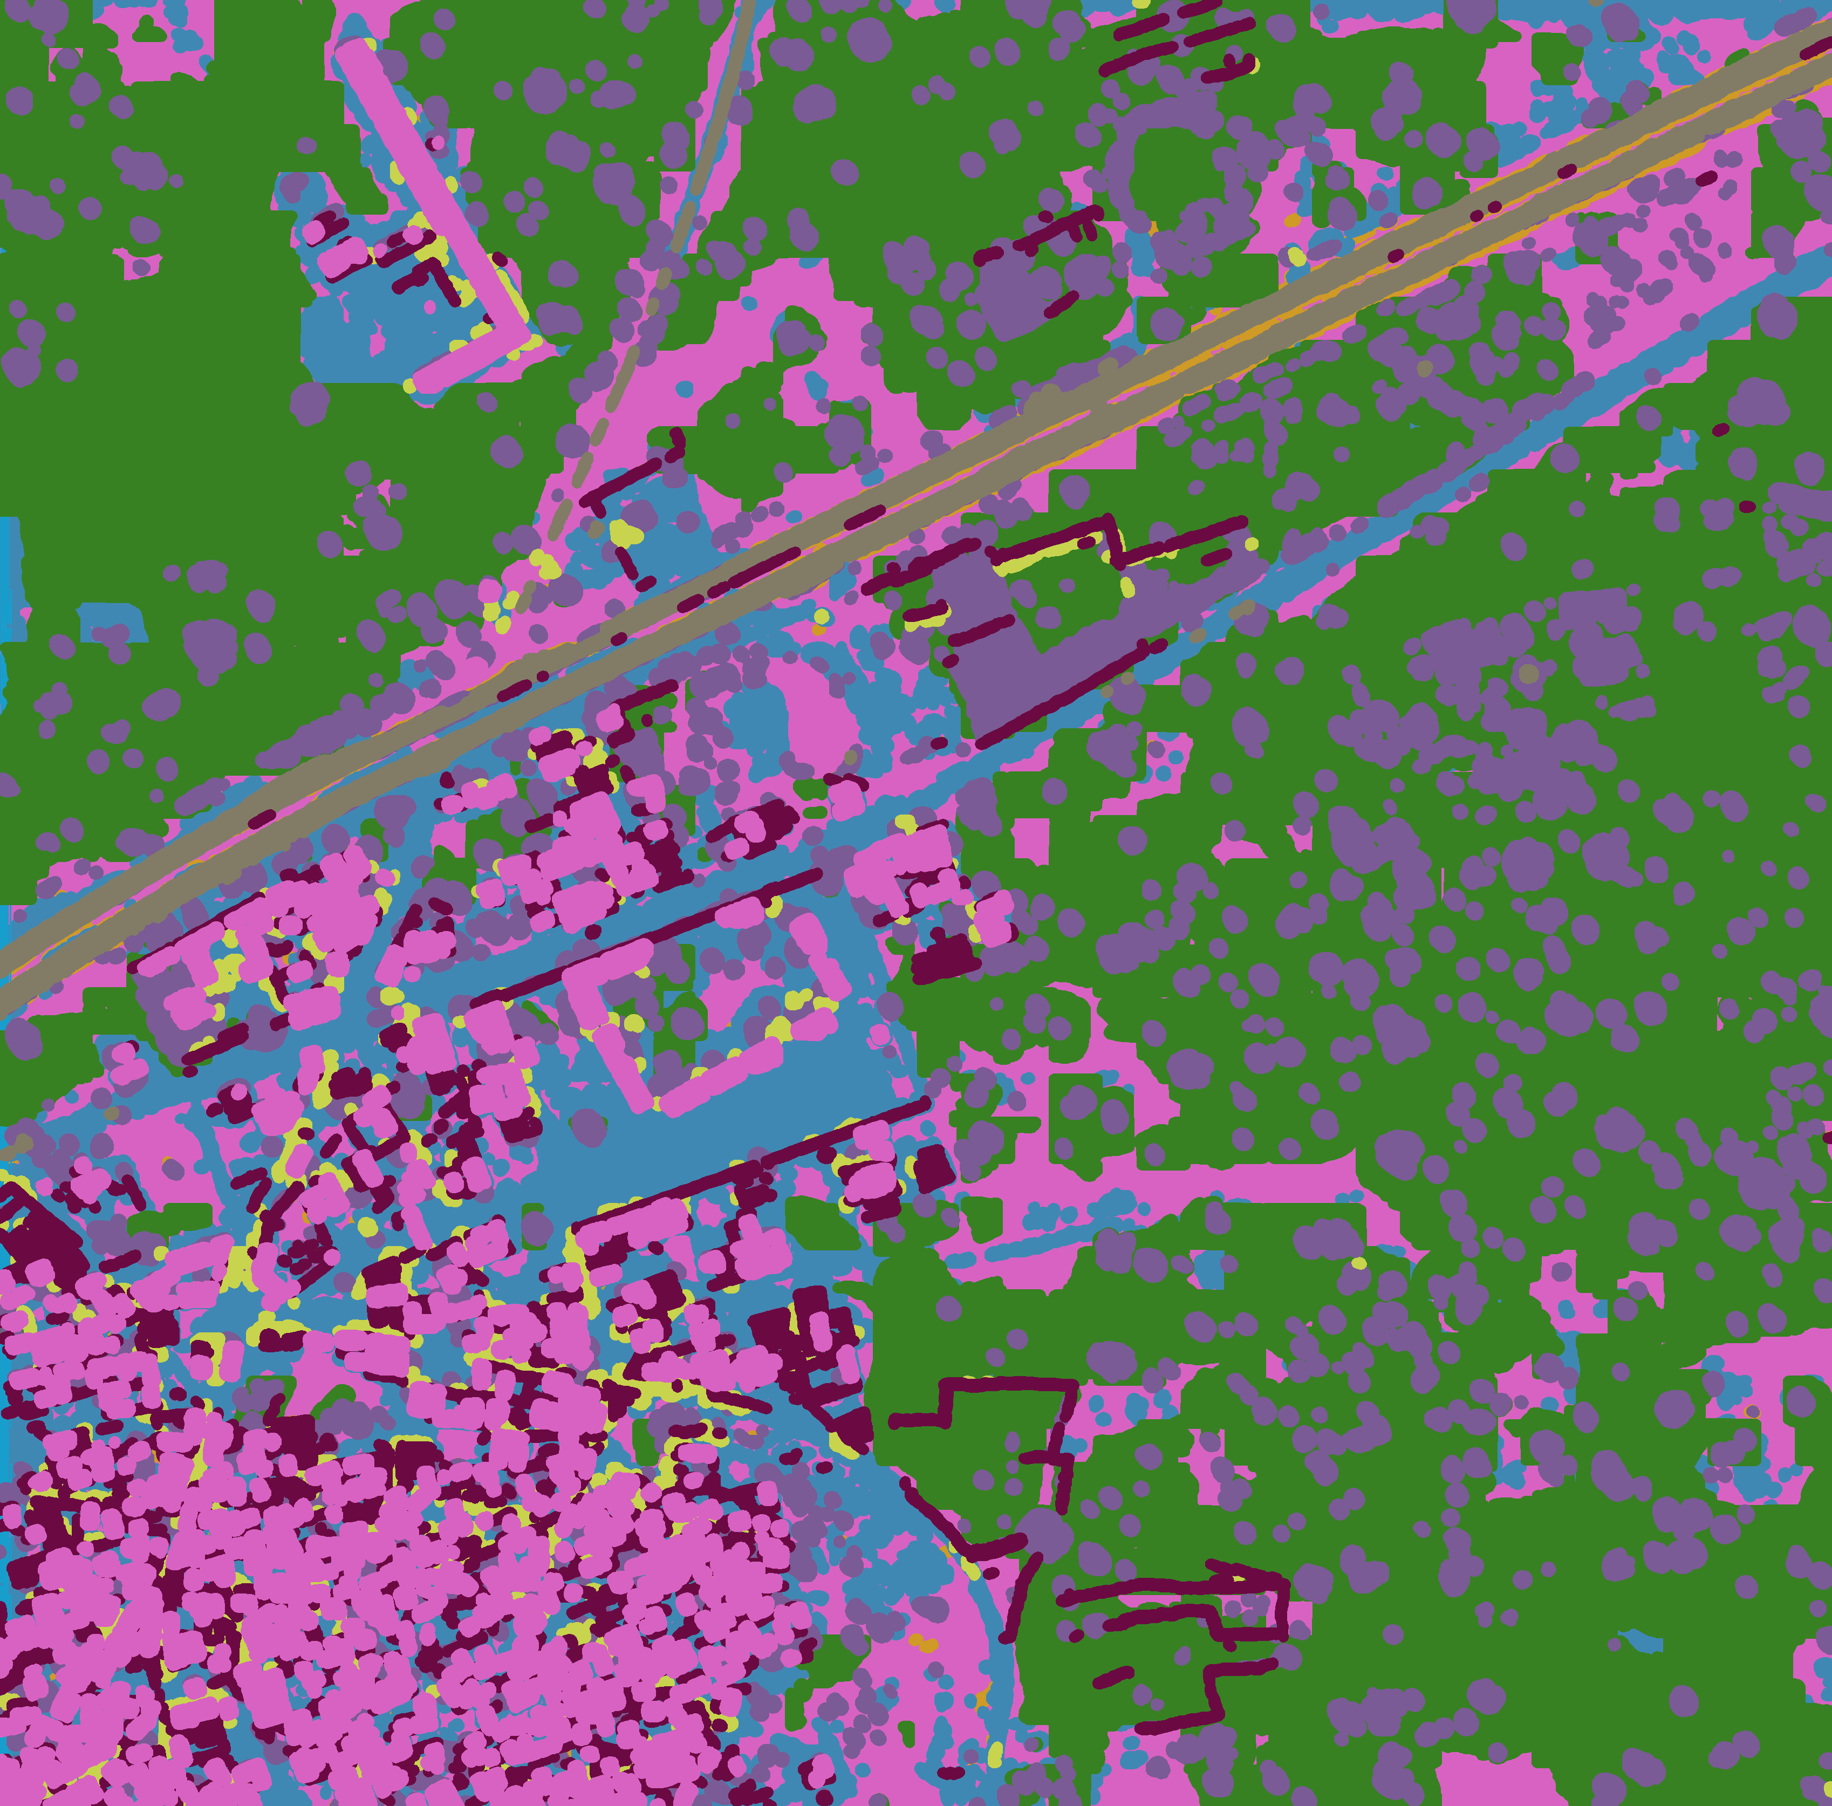
Results and Conclusions
Example Raw image of 6110_3_1 in the training set (left), mask generated from labeled polygon (middle) and segmented image predicted (right)

Slide 13

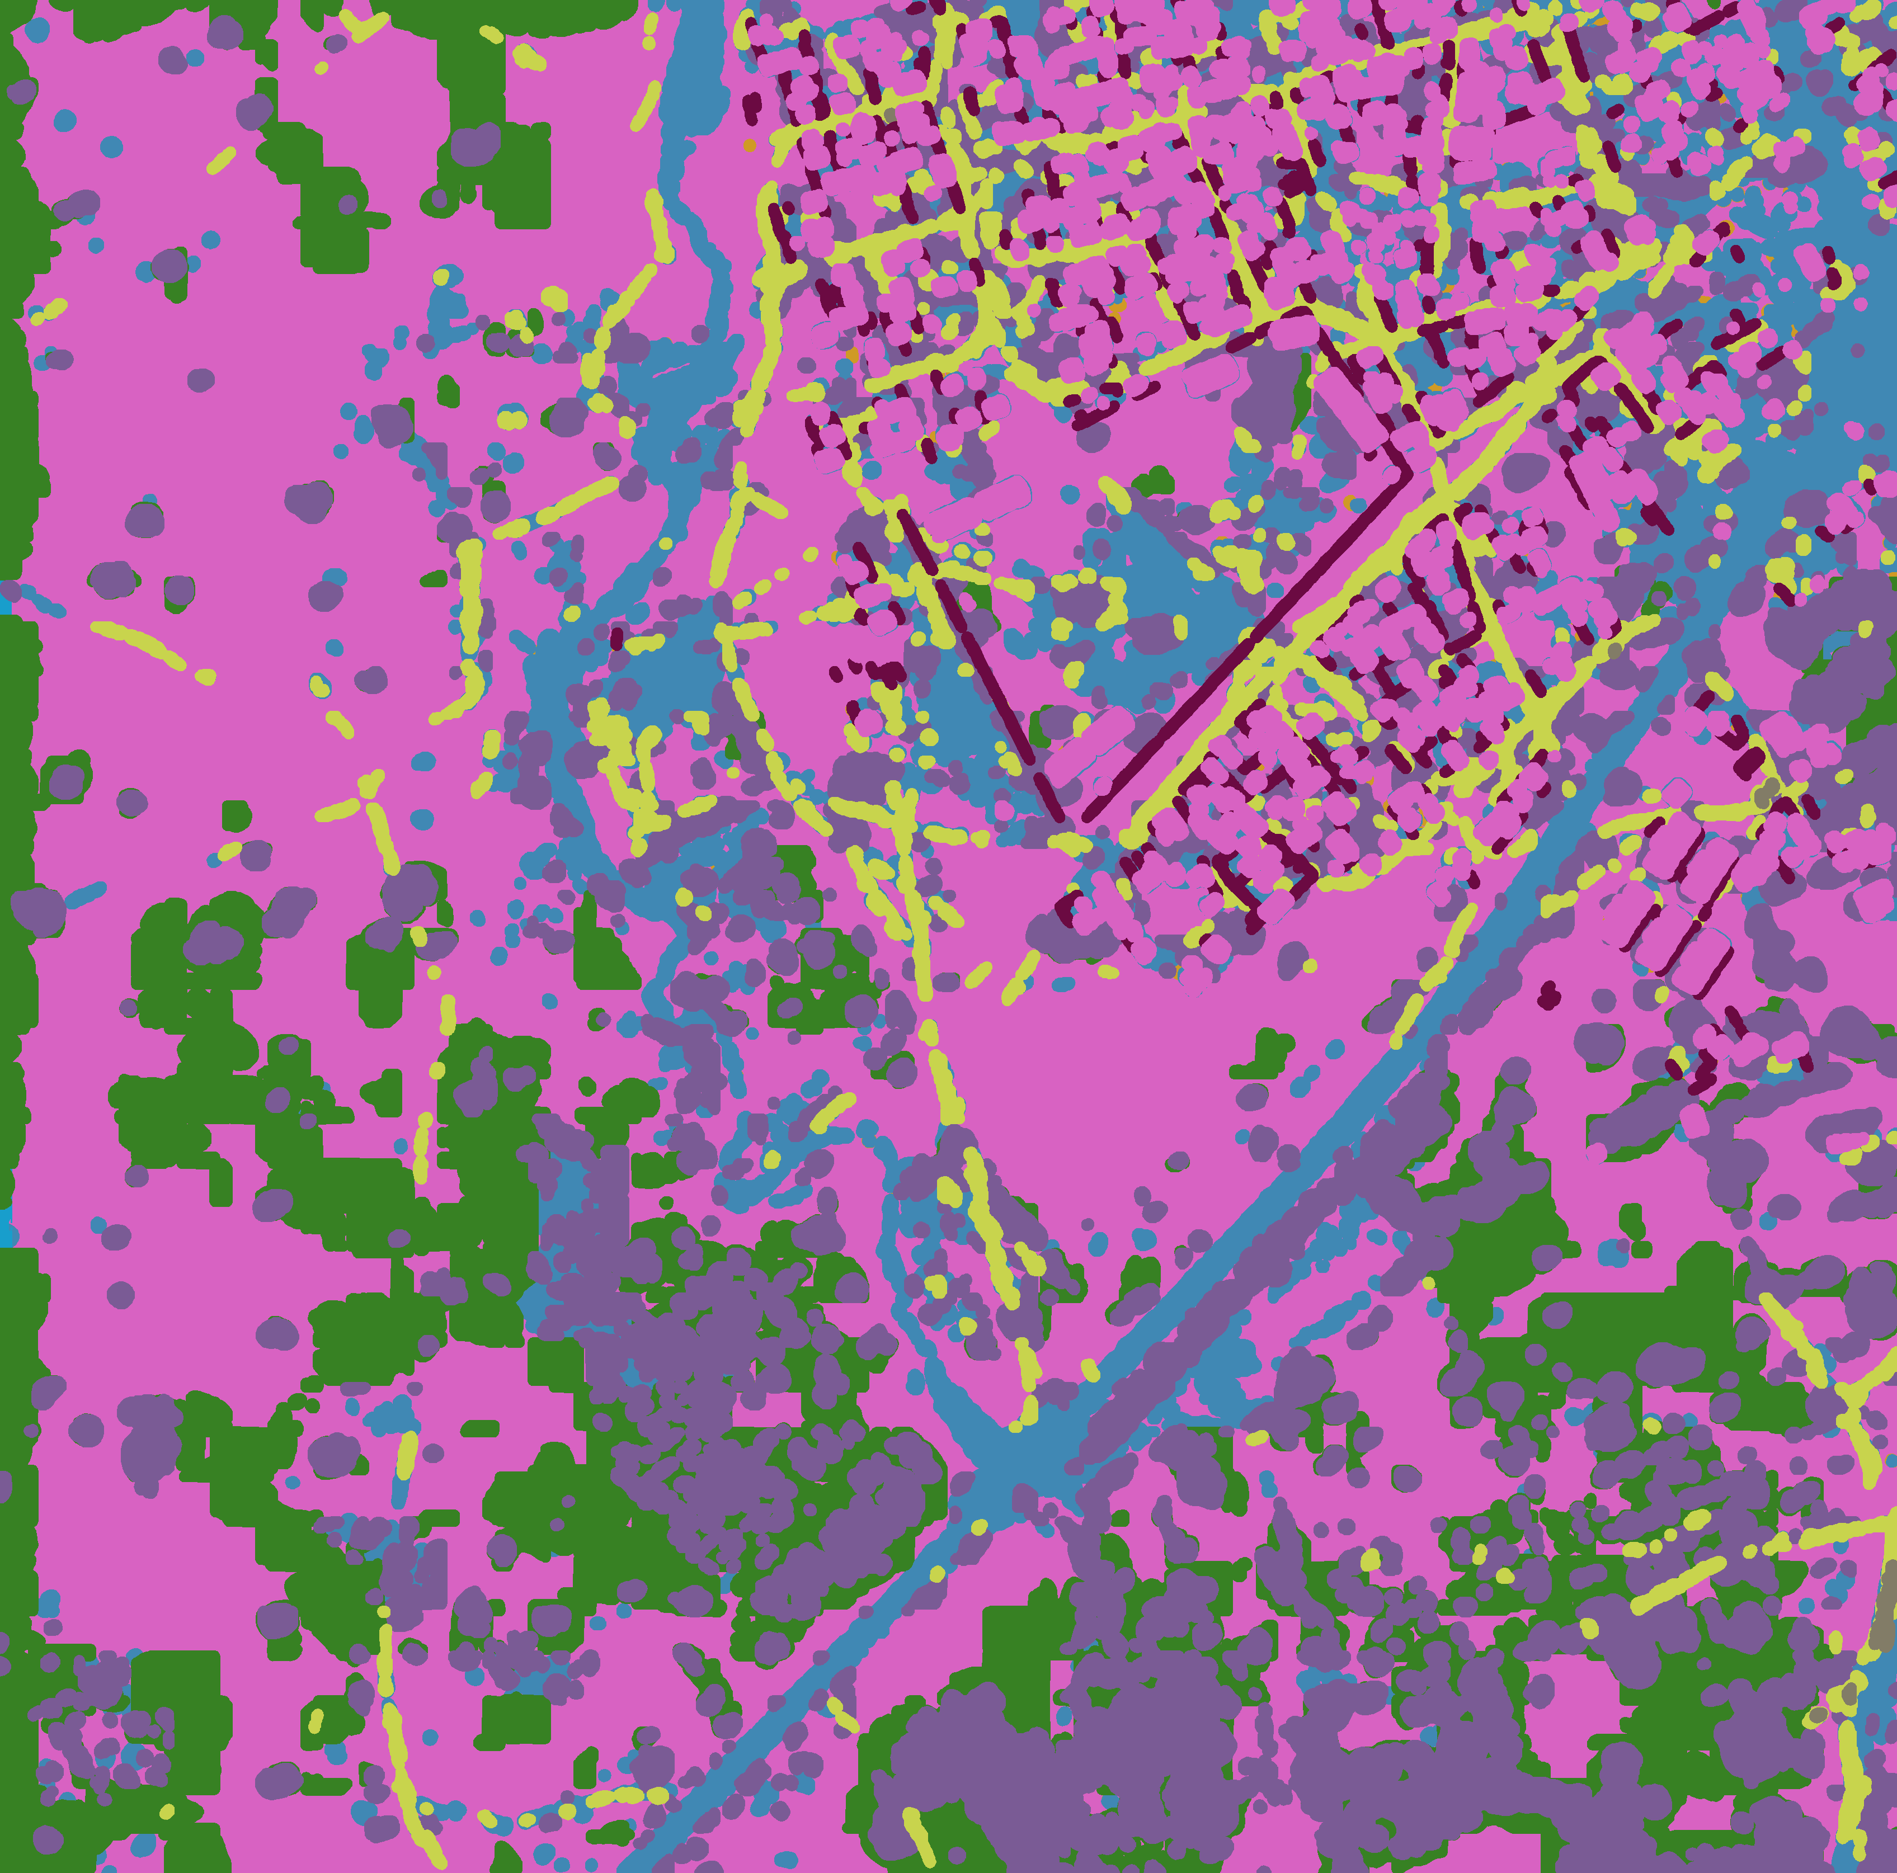
Results and Conclusions
Example Raw image of 6100_2_2 in the training set (left), mask generated from labeled polygon (middle) and segmented image predicted (right)

Slide 14
Results and Conclusions
Example Raw image of 6050_4_4 in the test set (left), and segmented image predicted (right)

Slide 15
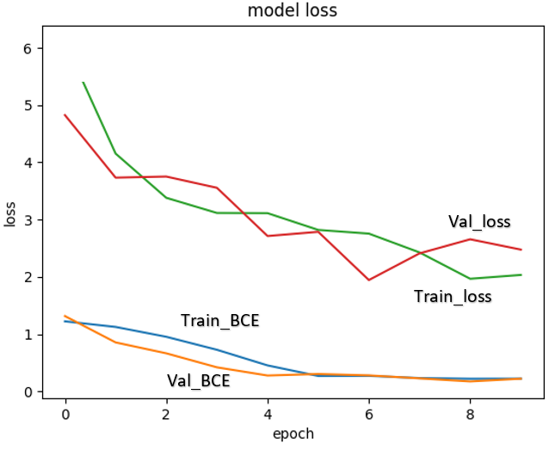
Results and Conclusions
Model converge as loss function (-log(jaccard) + BCE) and BCE loss decrease with epochs.
Example of a BCE loss function scores for the building and structure data.
Notes:
Samples in each epoch were generated randomly from the data.

Slide 16
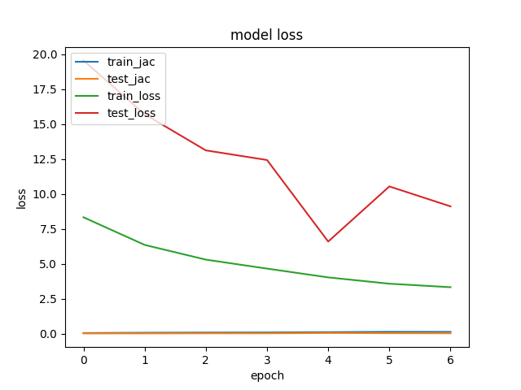
Results and Conclusions
Road and Tracks
Notes:
Talk about water and vehicle similarity here? Reference 2017 paper with similar results for general image detection?

Slide 17
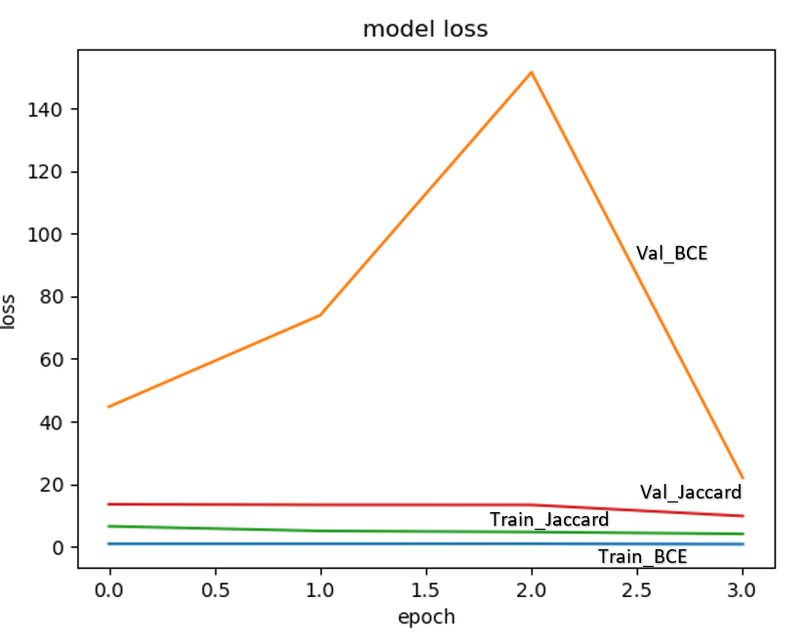
Results and Conclusions
Trees and Crops
Notes:
Talk about water and vehicle similarity here? Reference 2017 paper with similar results for general image detection?

Slide 18
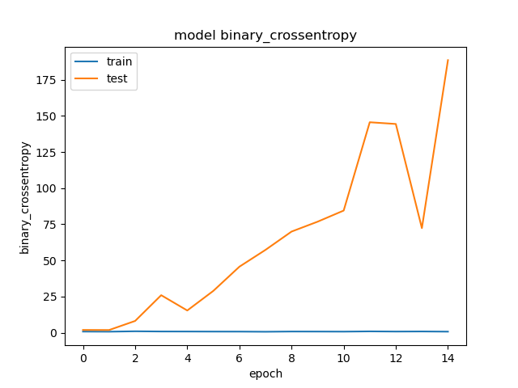
Results and Conclusions
The number of epochs and the amount of samples in each epoch played a significant role in improving performance.
Overfitting occurs after Epoch 1
Example of a BCE score for the trees and crops data. Epochs stop before overfitting occurs.
Notes:
Samples in each epoch were generated randomly from the data. This is after the training!

Slide 19
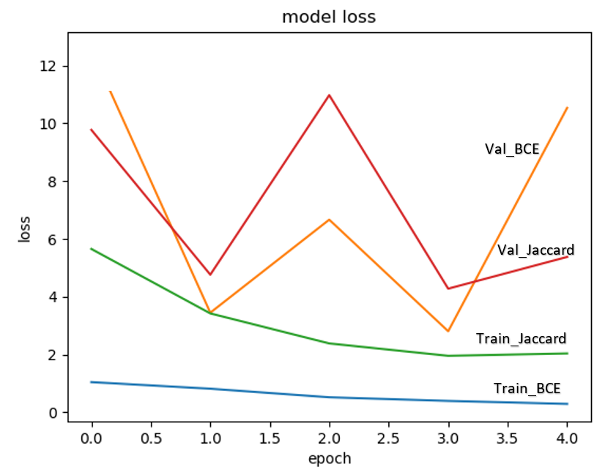
Results and Conclusions
Large and Small Vehicles
Notes:
Talk about water and vehicle similarity here? Reference 2017 paper with similar results for general image detection?

Slide 20
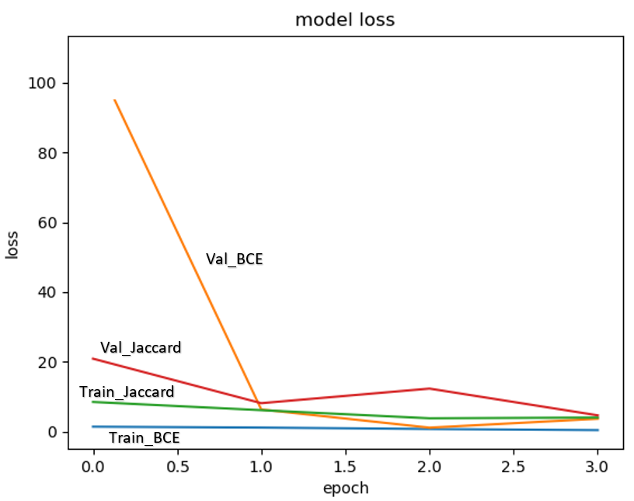
Results and Conclusions
Standing and Moving Water
Notes:
Talk about water and vehicle similarity here? Reference 2017 paper with similar results for general image detection?

Slide 21


Results and Conclusions
Limitations and Challenges
The most impactful limitation to this project was a lack of time.
Because our goal was to distinguish between two similar features, we had to build many models. The large size of the data meant it took a very long time to run these models and perform our analysis, even with the help of GPU!
Time
A surprising challenge was building models from the training data.
Each picture was massive, but there were not that many unique images. This increased the likelihood of overfitting and reduced performance because subsamples of our training data were augmented and duplicated multiple times. Some features were also remarkably similar and hard to distinguish.
Data
Notes:
Talk about water and vehicle similarity here? Reference 2017 paper with similar results for general image detection?

Slide 22




Results and Conclusions
Learnings and Future Opportunities
The U-Net architecture lent itself well to new techniques such as batching the images from our dataset or implementing new types of augmentation.
There were many existing resources and research to help guide this project.
This project could be the first step of a multi-tiered pipeline build to take advantage of image segmentation and explore other relationships in the data.
Image segmentation is a unique style of NN learning and techniques learned in this project could apply to many other problems.
Notes:
New types of augmentation include masking, patches from data, etc…
Resources and research include:
Existing papers, many Kaggle posts, and a good amount of support for building a U-Net in Keras.
The five models in this set could be merged to ‘cover more ground’ – a conglomerated model could learn even more from other objects nearby. A vehicle might increase the likelihood of a road being classified and vice-versa. Other networks like resnet could also be explored.
Other problems: Maybe NLP? Where the probabilities for words in a 1-D convolution layer Could

